Slide 1
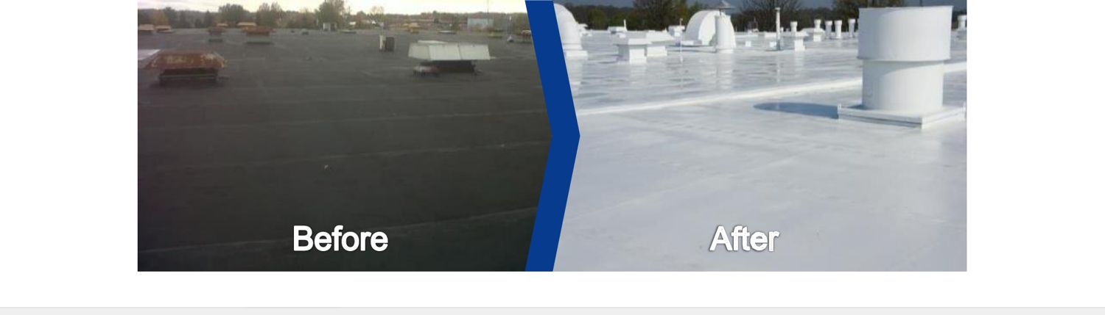
Henry Roof Restoration & Repair
GOLD SEAL TRAINING
Save the roof. Don't replace it.
Notes:
KEY MESSAGE
Today you'll learn how to bring an old roof back to life — and how to get Henry's best warranty behind your work.
SAY IT LIKE THIS
Welcome. Over the next sessions we'll cover how to tell if a roof can be saved, how to do the work right, and how to get it warranted. No test at the end. Just ask questions as we go.
MAKE IT STICK
Start with a story: a roof you saved that the owner thought was a goner. People remember stories, not bullet points.
ASK THE CREW
"Raise your hand if you've ever coated a roof." This tells you who your experts are, so you can call on them later.
(Original deck: slide 1)

Slide 2
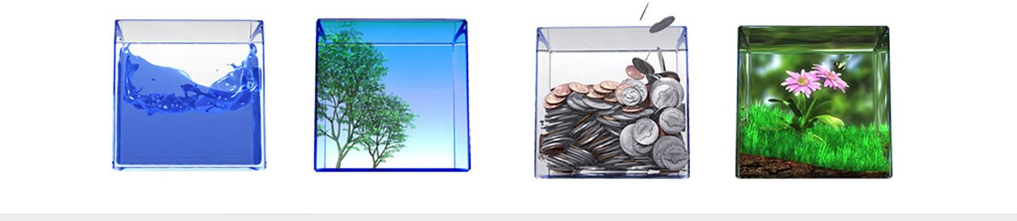
What We'll Cover
WELCOME
Who Henry is
How roofs age — and your options
Is this roof worth saving?
The restoration steps
Our four coating systems and repair products
Warranties, inspections, and support
Notes:
KEY MESSAGE
Here's the road map. Six stops.
SAY IT LIKE THIS
Read the list once, fast. Tell them when breaks are. Tell them it's OK to stop you and ask.
MAKE IT STICK
The four icons stand for what a good roof does: keeps water out, controls air, saves energy, and lasts.
ASK THE CREW
"What's one thing you want to walk out of here knowing?" Write answers on a flip chart and check them off at the end.
(Original deck: slide 2)

Slide 3
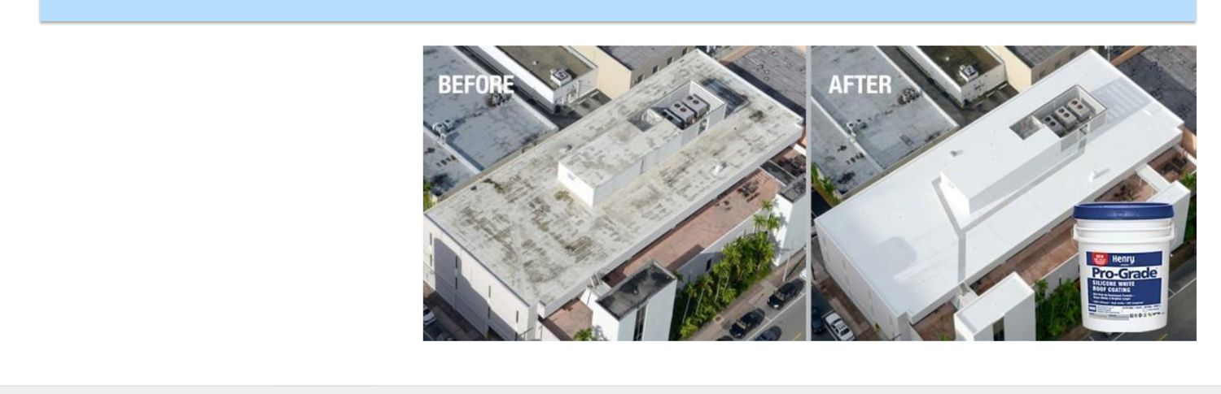
Who Is Henry? — For Building Owners
WELCOME
90+ years helping commercial roofs last longer
Coatings that add years to an old roof
Cooler roofs — lower power bills
Check-up plans that catch problems early
Less old roofing in the landfill
Notes:
KEY MESSAGE
For owners, Henry means more years from the roof they already paid for.
SAY IT LIKE THIS
This is how we talk to building owners. They care about money, time, and fewer headaches. Our coatings give them more life from the roof they already have.
MAKE IT STICK
Henry's motto is "the gift of time." Time is what an owner buys when they restore instead of replace.
(Original deck: slide 3)

Slide 4
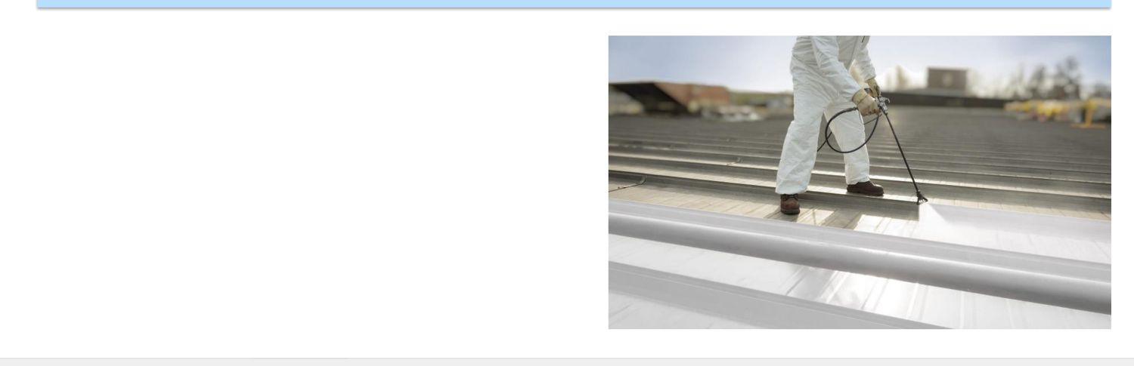
Who Is Henry? — For You, the Contractor
WELCOME
One full system — less time on the roof
A brand your customers trust
We send you leads — more time working, less time hunting
Training that makes your crew faster
Notes:
KEY MESSAGE
For contractors, Henry means easier jobs, more jobs, and backup when you need it.
SAY IT LIKE THIS
This one's about you. One system that works together. Leads from us. Training like today. And people to call when you're stuck.
ASK THE CREW
"What slows your crew down most on a coating job?" Keep that answer in mind — we'll come back to it.
(Original deck: slide 4)

Slide 5
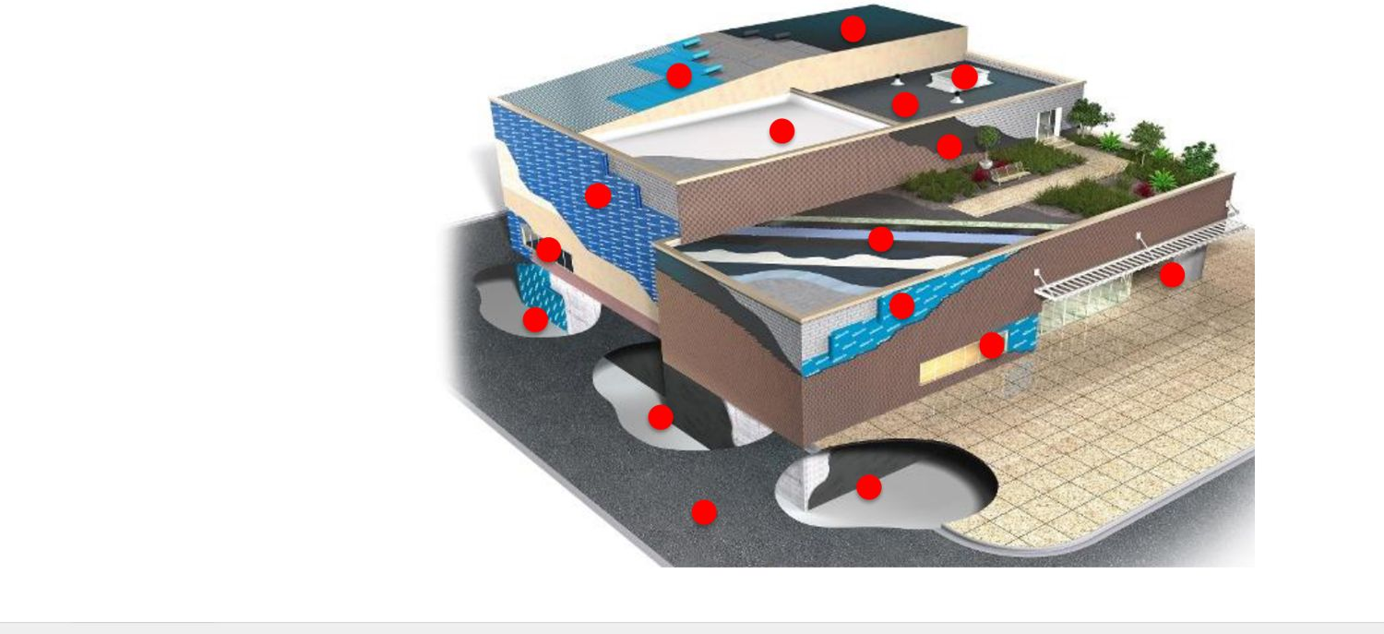
We Cover the Whole Building
WELCOME
Walls — air barriers, flashings, sealants
Below ground — waterproofing
Roof — coatings, underlayments, flashings, mod-bit, green roofs
Other — paving care and specialty products
Notes:
KEY MESSAGE
Henry protects the whole building, from the foundation to the roof.
SAY IT LIKE THIS
Each red dot on the drawing is a product area. Today we focus on one: roof restoration coatings.
(Original deck: slide 5)

Slide 6
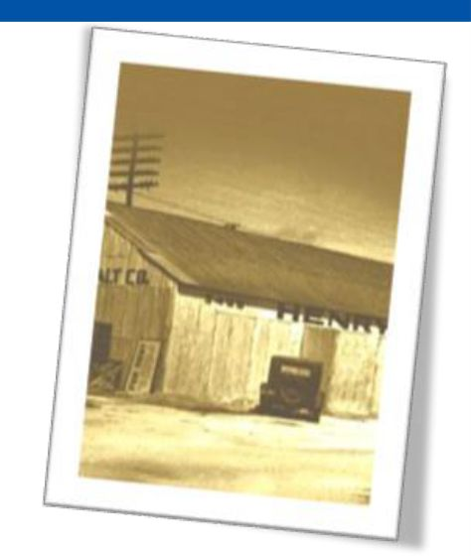
Our Story in Five Dates
WELCOME
1933 — Henry starts
1981 — Henry incorporates
2020 — Henry buys National Coatings, known for strong acrylics
2021 — Carlisle buys Henry. One company now covers the building from below ground to the roof.
2023 — Henry, Carlisle coatings, and National Coatings join as one: Henry, a Carlisle Company
Notes:
KEY MESSAGE
Over 90 years old, and now part of Carlisle — one of the biggest names in roofing.
SAY IT LIKE THIS
Keep this short. The point: we've been around a long time, and we keep getting stronger.
(Original deck: slide 6)

Slide 7
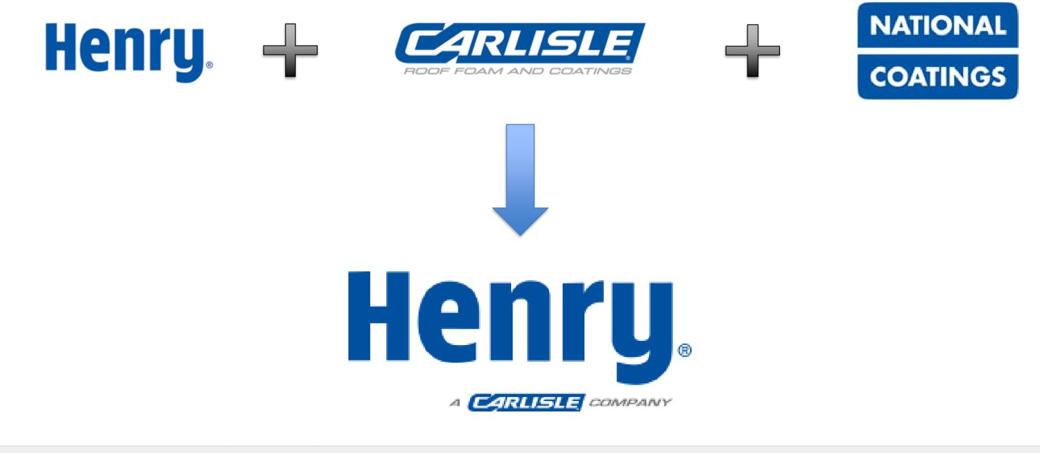
One Team: Henry + Carlisle + National Coatings
WELCOME
Three strong brands. One name: Henry.
Notes:
KEY MESSAGE
Three companies came together. You deal with one name: Henry.
SAY IT LIKE THIS
If you used Carlisle coatings or National Coatings before, those products now live under Henry.
(Original deck: slide 7)

Slide 8
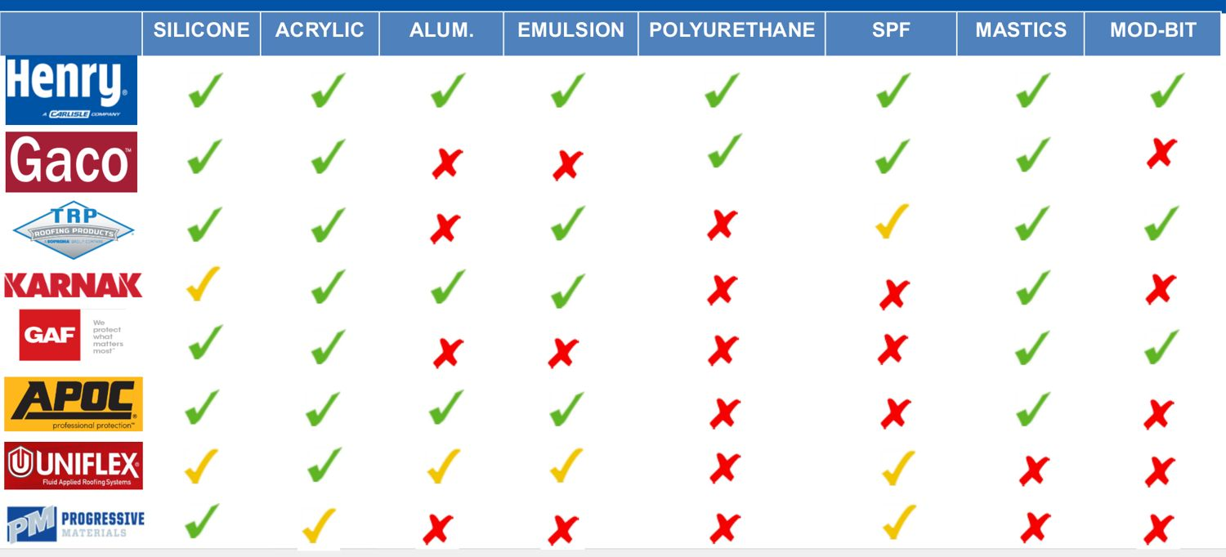
Henry vs. the Competition
WELCOME
Henry makes every type of coating on this chart. Most brands don't.
Notes:
KEY MESSAGE
One supplier for every coating type: silicone, acrylic, aluminum, emulsion, foam, and mastics.
SAY IT LIKE THIS
Look at the top row — all green checks. That means whatever the roof needs, you can get it from one place, with one warranty.
ASK THE CREW
"Why does one supplier for everything matter to you?" (One call, one warranty, one rep.)
(Original deck: slide 8)

Slide 9

Five Choices for Any Roof
WELCOME
New — a brand-new roof on a new building
Repair — fix small problems to keep a roof going
Restore — coat the roof you have (today's focus)
Recover — put a new roof over the old one
Replace — tear it all off and start over
Notes:
KEY MESSAGE
Restore sits in the sweet spot: less cost and mess than recover or replace.
SAY IT LIKE THIS
Every roof goes around this circle. Restoration is the step that buys the most years for the least money — if we catch the roof in time.
MAKE IT STICK
Like a car: oil changes (repair), a rebuild (restore), or a new car (replace). Most people wait too long and end up buying new.
(Original deck: slide 9)

Slide 10
Every Roof Wears Out
WELCOME
Sun and heat break roofs down over the years
Old roofs start to leak — and owners think "replace it"
Often only 5–10% needs repair
The rest can be restored
Notes:
KEY MESSAGE
A leaking roof is not always a dead roof.
SAY IT LIKE THIS
When an owner sees a leak, they think the whole roof is shot. Usually it's not. Most of the time a small part needs fixing and the rest just needs a new coat.
MAKE IT STICK
One bad tooth doesn't mean you pull them all.
ASK THE CREW
"How many of you have walked a 'dead' roof that was actually 90% fine?"
(Original deck: slide 10)

Slide 11
Restore or Replace?
WELCOME
Replace
Restore
Big up-front cost
Business gets disrupted
Tons of waste
Coat the roof you have
A fraction of the cost
Adds years of life
Works if less than 25% needs replacing
Notes:
KEY MESSAGE
If less than 25% of the roof needs replacing, restore it.
SAY IT LIKE THIS
Every owner will face this choice. Replacement costs a lot and shuts things down. Restoration costs a fraction and adds years. But there's a window — wait too long and restoration is off the table.
MAKE IT STICK
Remember the number 25. Under 25% bad: restore. Over 25%: replace.
ASK THE CREW
"What's the magic number?" (25%.) Ask it again later in the day.
(Original deck: slide 11)

Slide 12

Why Building Owners Like It
WELCOME
Lowest up-front cost
Little waste to haul away
Possible tax breaks and rebates
Lower energy bills
Fewer repairs
Shields the roof from sun, hail, foot traffic, chemicals, and heat swings
Can be recoated again later
Notes:
KEY MESSAGE
Owners save money now and later.
SAY IT LIKE THIS
These are the selling points for the owner. Pick the two or three that matter most to the customer in front of you — don't read them the whole list.
ASK THE CREW
"Which one of these would your customers care about most?"
(Original deck: slide 12)

Slide 13

Why Contractors Like It
WELCOME
Spray or roll — less labor
Low equipment cost
Safer — no hot tar, no torches
New workers learn it fast
Easy to set up and move
Repeat work — maintenance for the life of the building
Henry helps you sell it
Notes:
KEY MESSAGE
Restoration is safer, faster work — and it brings you back to the same roof for years.
SAY IT LIKE THIS
No kettles, no torches. Easier to train new hires. And once you coat a roof, you can keep that customer for maintenance.
ASK THE CREW
"What's the hardest part of training a new guy on hot work?" Compare that to rolling coating.
(Original deck: slide 13)

Slide 14
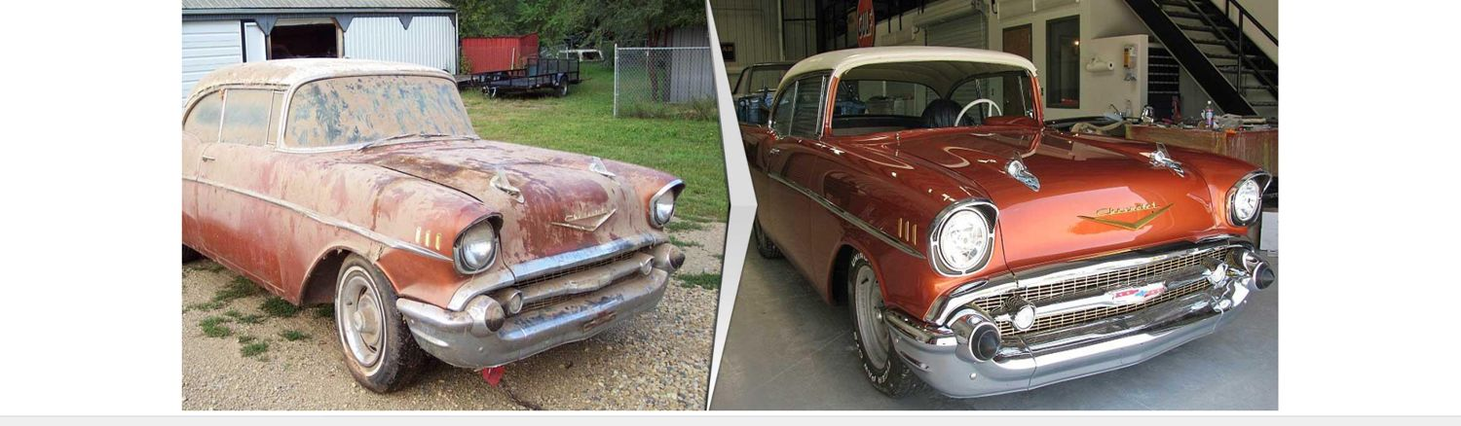
Make the Old New Again
WELCOME
Restoring makes a roof watertight again
It also makes the roof save energy again
Same roof — works and looks like new
Notes:
KEY MESSAGE
Restoration is a rebuild, not a cover-up.
SAY IT LIKE THIS
Look at the car. Same car, same frame. Fixed up, it runs and looks great. That's what we do to a roof.
MAKE IT STICK
Nobody junks a classic car because the paint faded. Same with a roof that's still solid underneath.
(Original deck: slide 14)

Slide 15



Is the Roof a Good Fit? Three Rules
WELCOME
1. Clean
2. Dry
3. Sound
Dirt, oil, and loose stuff removed
No water trapped inside
Solid deck, no big damage
Notes:
KEY MESSAGE
Clean. Dry. Sound. If a roof fails one, it's not ready.
SAY IT LIKE THIS
This is the most important slide today. Every roof we restore has to pass all three. If it's dirty, we clean it. If it's wet, we dry or replace the wet part. If it's not solid, we repair it first — or walk away.
MAKE IT STICK
Say it out loud together: "Clean, dry, sound." Repeat it at the end of every section today.
ASK THE CREW
"Give me an example of a roof that's clean and dry but NOT sound."
(Original deck: slide 15)

Slide 16
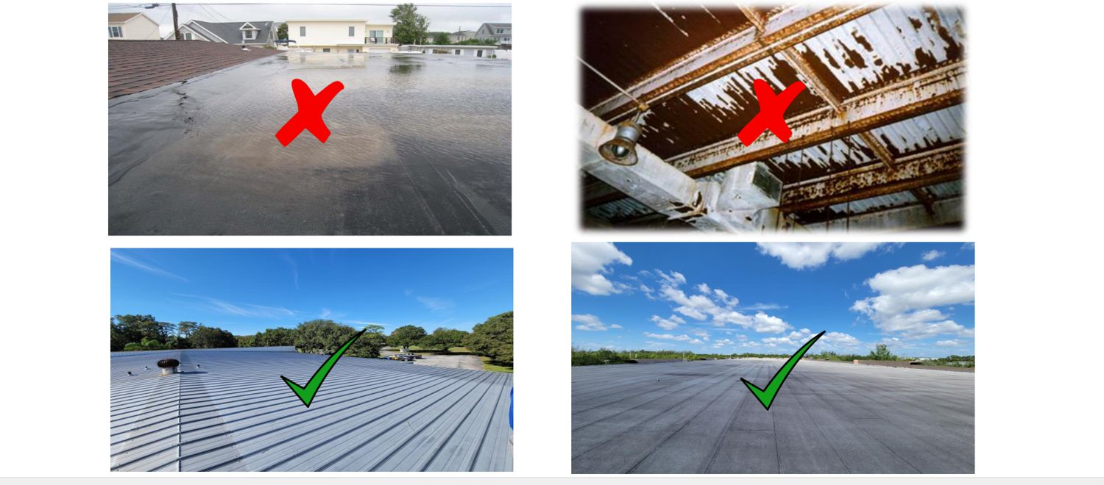
Good Fit or Not? (1)
WELCOME
Green check = good candidate. Red X = not ready.
Notes:
KEY MESSAGE
Use Clean, Dry, Sound to judge each photo.
SAY IT LIKE THIS
Don't tell them the answer. Point at each photo and let the room decide. Then reveal why.
ASK THE CREW
"Why does the top-right one get an X?" (Not sound — the deck is damaged.)
(Original deck: slide 16)

Slide 17
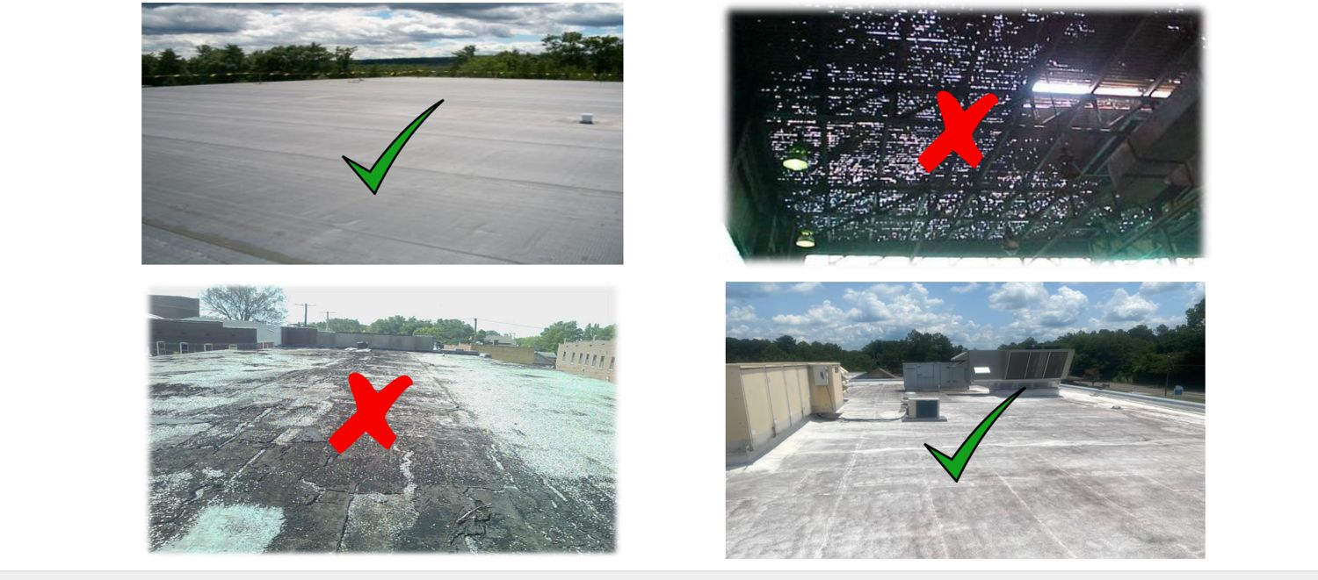
Good Fit or Not? (2)
WELCOME
Practice: which rule does each red X break?
Notes:
KEY MESSAGE
More practice. The crew should be calling these on their own now.
SAY IT LIKE THIS
Same game. This time, have someone else explain each answer.
ASK THE CREW
"Which rule — clean, dry, or sound — does each X break?"
(Original deck: slide 17)

Slide 18
Pro-Grade 988 Silicone System
SILICONE
REMEMBER
Silicone: the best choice where water sits.
Notes:
KEY MESSAGE
Section 1 of 4: Silicone.
SAY IT LIKE THIS
We start with silicone because it's our strongest system and it handles the hardest problem on flat roofs: standing water.
(Original deck: slide 18)

Slide 19
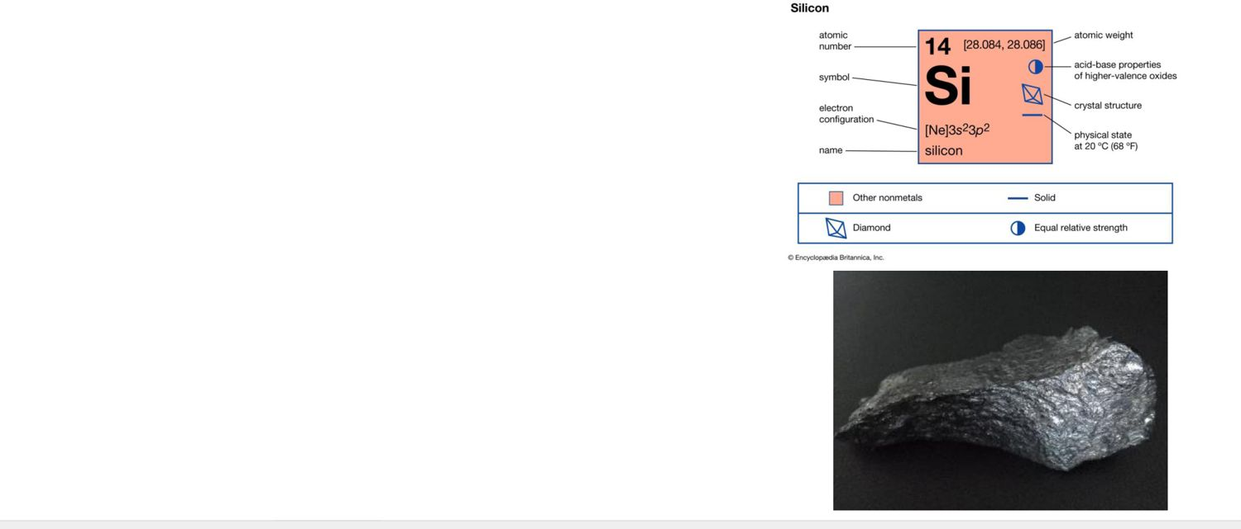
Silicone: The Strengths
SILICONE
Stays flexible from -15°F to 180°F
Stretches without cracking. Sticks very well.
Water can't soak through it
Cures from moisture in the air — standing water won't soften it
Holds up to sun — loses only about 0.1 mil a year
90%+ solids — more of what you spray stays on the roof
Apply at 35°F and rising. Low fumes. Won't chalk.
Notes:
KEY MESSAGE
Silicone stays put — through heat, cold, sun, and standing water.
SAY IT LIKE THIS
High solids means when you put 10 gallons down, about 9 stay on the roof. It cures with moisture, so ponding water can't turn it back to goo.
MAKE IT STICK
Fun fact: silicon is the second most common element on Earth — about 27% of the earth's crust. It's basically made from sand.
ASK THE CREW
"Why do high solids matter to you as the installer?" (Less material, thicker film, fewer coats.)
(Original deck: slide 19)

Slide 20
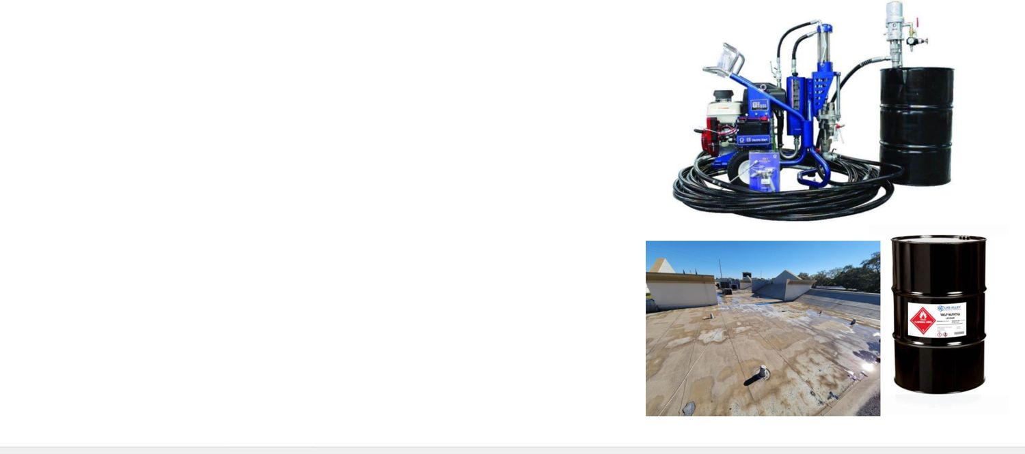
Silicone: The Downsides
SILICONE
Picks up dirt more easily
Only silicone sticks to silicone later
Asphalt can stain through — needs a basecoat
Harder to clean tools and spray rigs
Needs commercial spray equipment
Many crews haven't used it yet — newer tech (about 20 years)
Notes:
KEY MESSAGE
Know the downsides so you can plan for them — not so you avoid silicone.
SAY IT LIKE THIS
Be honest with customers about this. Most of these have a fix: our 988 resists dirt, the 294 basecoat stops asphalt stains, and training fixes unfamiliarity.
MAKE IT STICK
Silicone is a one-way street: once a roof is silicone, it stays silicone.
(Original deck: slide 20)

Slide 21
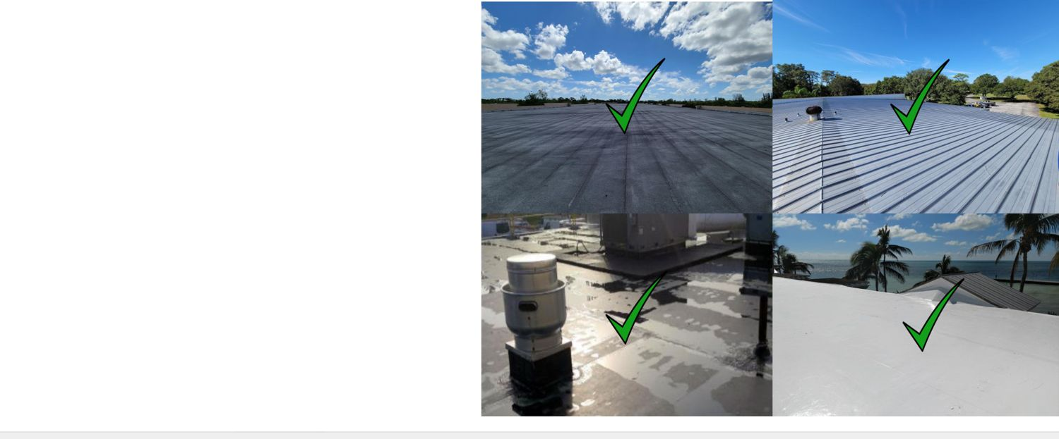
When Silicone Is a Good Fit
SILICONE
Flat roofs
Low slopes — 3:12 or less
Very hot or very cold places
Max sun protection
Areas where water sits*
*Puddles, not lakes. The roof must still drain.
Notes:
KEY MESSAGE
Flat, low-slope, harsh weather, ponding water: think silicone.
SAY IT LIKE THIS
Ponding water is where silicone shines. But read the footnote: puddles, not lakes. The roof still has to drain.
(Original deck: slide 21)

Slide 22
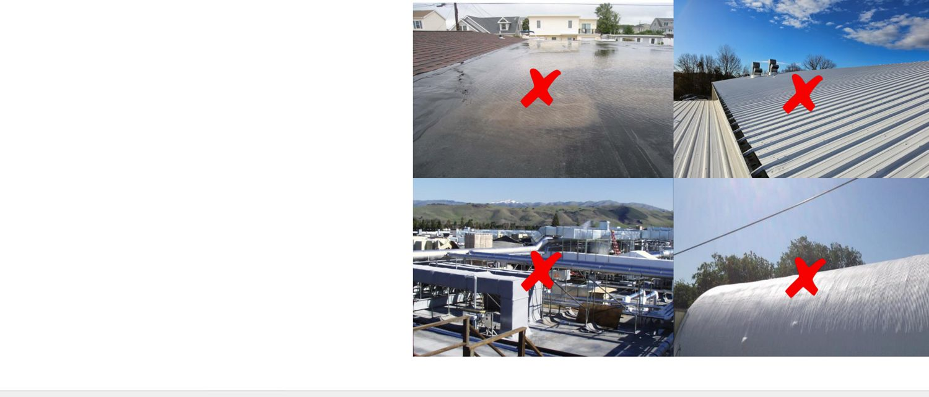
When Silicone Is NOT a Good Fit
SILICONE
Deep standing water* — lakes on the roof
Steep roofs — more than 3:12
Barrel (curved) roofs
Heavy foot traffic areas
*Silicone handles puddles — not swimming pools.
Notes:
KEY MESSAGE
Steep, curved, high-traffic, or swimming-pool roofs: pick something else.
SAY IT LIKE THIS
Silicone runs on steep slopes and gets slick to walk on. On a roof with heavy foot traffic, use a tougher topcoat or add walk pads.
ASK THE CREW
"A roof holds 4 inches of water for a week after rain. Silicone?" (No — fix the drainage first.)
(Original deck: slide 22)

Slide 23
What Roofs Can Silicone Restore?
SILICONE
REMEMBER
Silicone works on almost every roof type.
Notes:
KEY MESSAGE
Next: a quick photo tour of roof types silicone can restore.
SAY IT LIKE THIS
Keep these fast — about 20 seconds each. The point is: silicone goes on almost anything.
(Original deck: slide 23)

Slide 24
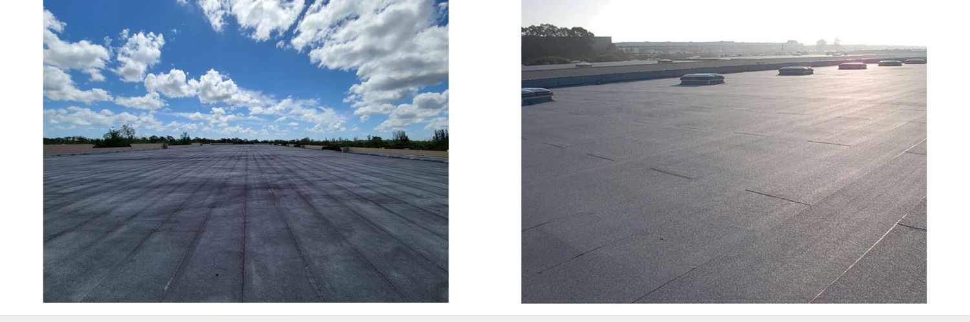
Asphalt Roofs
SILICONE
Granulated or smooth mod-bit, and BUR (built-up roof).
Notes:
KEY MESSAGE
This system works on asphalt roofs — granulated or smooth mod-bit, and built-up (BUR) roofs.
SAY IT LIKE THIS
Point at the photo. "If you see a roof like this, this coating can restore it — as long as it passes Clean, Dry, Sound." Over asphalt, use the 294 basecoat first to stop stains.
ASK THE CREW
"Where have you seen a roof like this around here?"
(Original deck: slide 24)

Slide 25
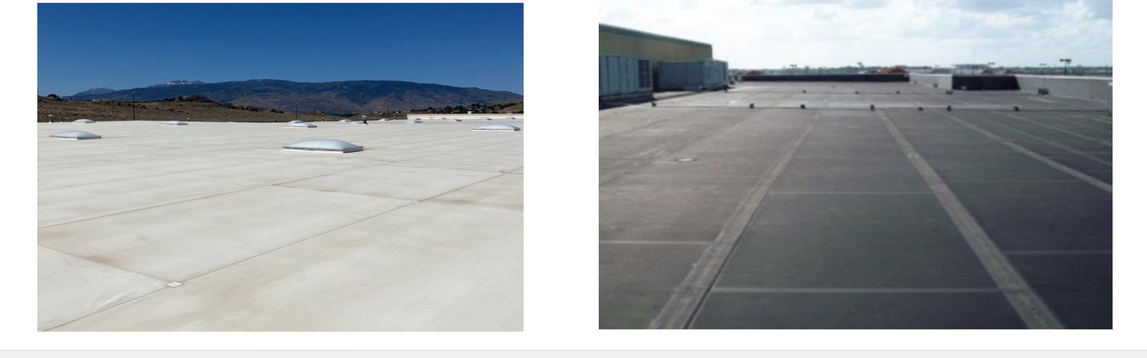
Single-Ply Roofs
SILICONE
TPO, PVC, and EPDM.
Notes:
KEY MESSAGE
This system works on single-ply roofs — TPO, PVC, and EPDM.
SAY IT LIKE THIS
Point at the photo. "If you see a roof like this, this coating can restore it — as long as it passes Clean, Dry, Sound." Single-ply always needs an adhesion test.
ASK THE CREW
"Where have you seen a roof like this around here?"
(Original deck: slide 25)

Slide 26
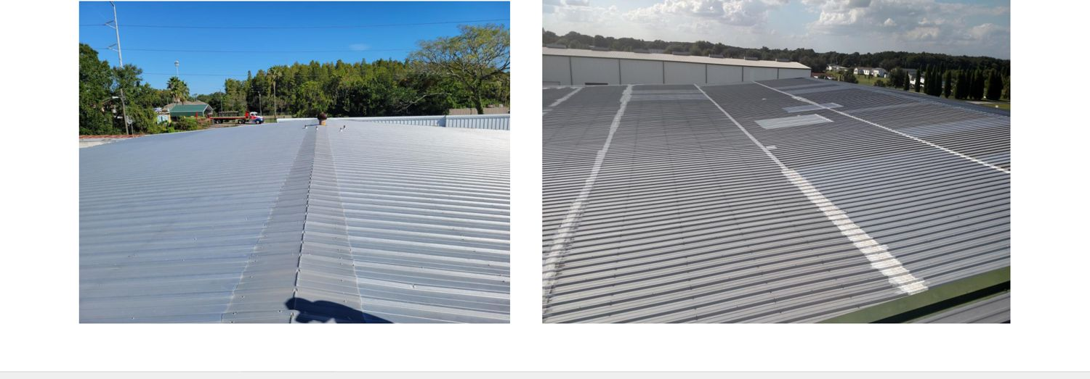
Metal Roofs
SILICONE
Standing seam and screw-down metal.
Notes:
KEY MESSAGE
This system works on metal roofs.
SAY IT LIKE THIS
Point at the photo. "If you see a roof like this, this coating can restore it — as long as it passes Clean, Dry, Sound." Metal always needs an adhesion test. No moisture survey needed.
ASK THE CREW
"Where have you seen a roof like this around here?"
(Original deck: slide 26)

Slide 27
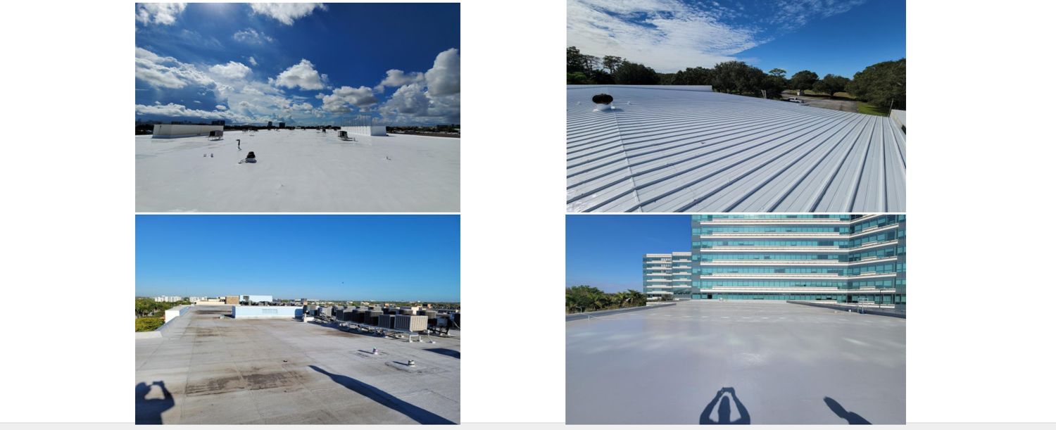
Roofs Coated Before
SILICONE
Old coatings can be restored — after an adhesion test.
Notes:
KEY MESSAGE
This system works on roofs that were coated before.
SAY IT LIKE THIS
Point at the photo. "If you see a roof like this, this coating can restore it — as long as it passes Clean, Dry, Sound." Always test adhesion over an old coating.
ASK THE CREW
"Where have you seen a roof like this around here?"
(Original deck: slide 27)

Slide 28
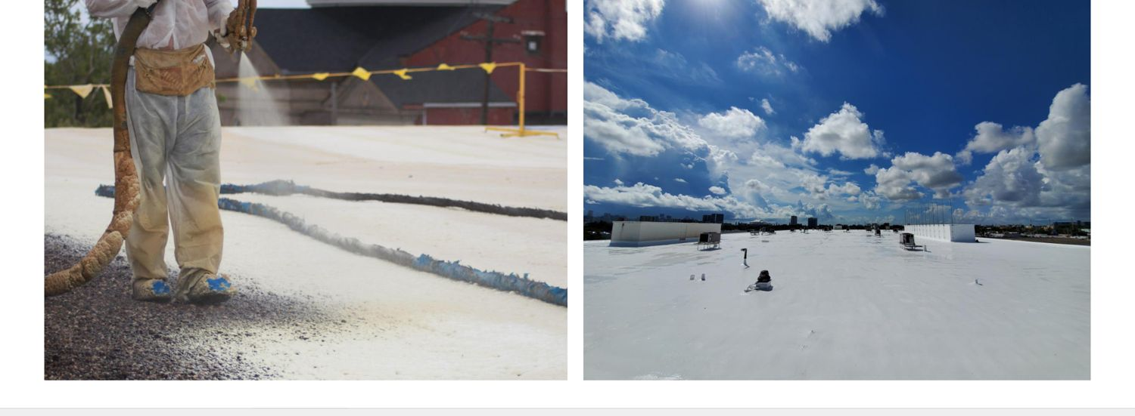
Spray Foam (SPF) Roofs
SILICONE
Silicone protects foam from the sun.
Notes:
KEY MESSAGE
This system works on spray foam (SPF) roofs.
SAY IT LIKE THIS
Point at the photo. "If you see a roof like this, this coating can restore it — as long as it passes Clean, Dry, Sound."
ASK THE CREW
"Where have you seen a roof like this around here?"
(Original deck: slide 28)

Slide 29
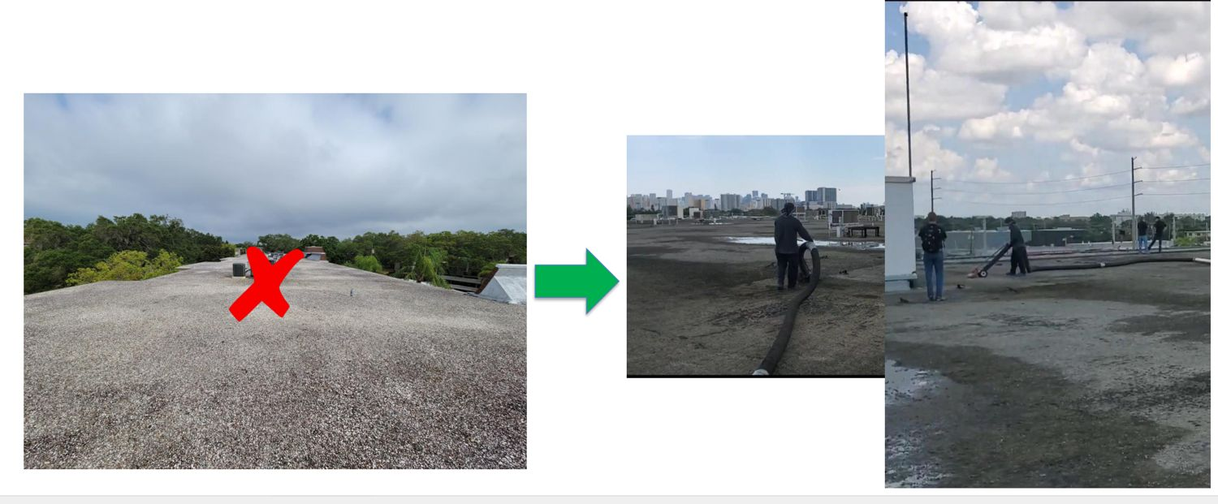
Tar & Gravel Roofs
SILICONE
Not ready as-is (red X). The gravel has to be dealt with first.
Notes:
KEY MESSAGE
This system works on tar and gravel roofs — once the gravel is handled.
SAY IT LIKE THIS
Point at the photo. "If you see a roof like this, this coating can restore it — as long as it passes Clean, Dry, Sound." Loose gravel can't be coated over.
ASK THE CREW
"Where have you seen a roof like this around here?"
(Original deck: slide 29)

Slide 30
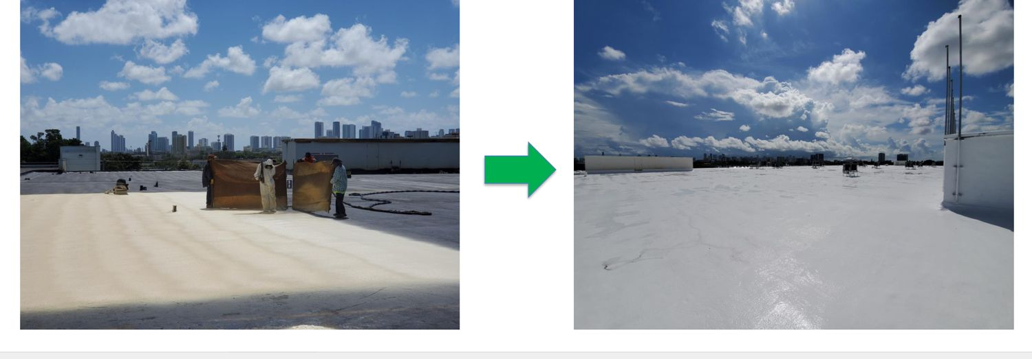
Tar & Gravel + Spray Foam
SILICONE
Spray foam over the old gravel roof, then coat it.
Notes:
KEY MESSAGE
This system works on tar and gravel roofs with spray foam on top.
SAY IT LIKE THIS
Point at the photo. "If you see a roof like this, this coating can restore it — as long as it passes Clean, Dry, Sound." Foam creates a new, smooth surface. Then silicone protects the foam.
ASK THE CREW
"Where have you seen a roof like this around here?"
(Original deck: slide 30)

Slide 31
Silicone Restoration Steps
SILICONE
REMEMBER
Repair first, then restore.
Notes:
KEY MESSAGE
Now: how we do a silicone job, start to finish.
SAY IT LIKE THIS
These steps are the same for every system. Learn them once here; we'll just review them later.
(Original deck: slide 31)

Slide 32
The Steps for a Warranted Job
SILICONE
1
2
3
Walk the roof
Adhesion test
Moisture survey
Look it over. (If needed)
Will the coating stick? (If needed)
Is it wet inside? (If needed)
4
5
6
Fix the roof
Restore
Final inspection
Repair what's broken
Apply the coating system
Check the work. (If needed)
Notes:
KEY MESSAGE
Six steps, every time. Skip one and the warranty can be at risk.
SAY IT LIKE THIS
This is the whole job on one slide. Look, test, check for water, fix, coat, inspect. The steps marked "if needed" depend on the roof and the warranty you're going for.
MAKE IT STICK
Think of it like a doctor visit: check-up, tests, treat the problem, then follow-up. You don't operate before the X-ray.
ASK THE CREW
"Which step do you think crews skip most often?" (Usually the adhesion test or the moisture survey.)
(Original deck: slide 32)

Slide 33
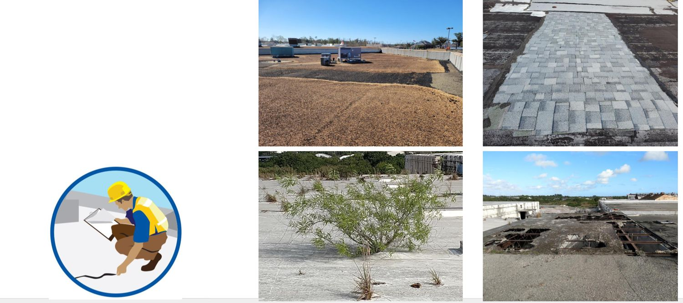
Step 1: Walk the Roof
SILICONE
Gold Seal jobs — best done with a Henry rep
It's free — no charge
We just need a way onto the roof
Notes:
KEY MESSAGE
Before anything else, put eyes on the roof — and invite Henry to come with you.
SAY IT LIKE THIS
Call your Henry rep. They walk the roof with you at no cost. All we need is roof access. Two sets of eyes catch more problems.
MAKE IT STICK
A free second opinion now beats a warranty claim later.
(Original deck: slide 33)

Slide 34
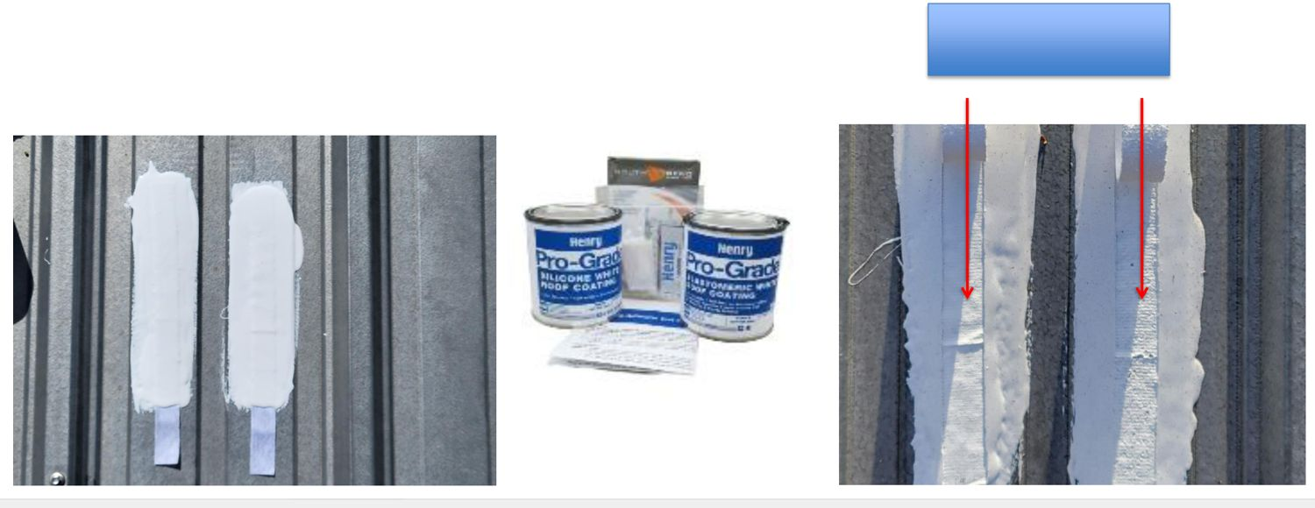
Step 2: Adhesion Test — Will It Stick?
SILICONE
Checks that the coating will stick to this roof
Required on — single-ply, metal, smooth asphalt, and roofs coated before
Best result — the coating tears before it lets go (called "cohesive failure")
Notes:
KEY MESSAGE
Test a small patch first. If it doesn't stick, nothing else matters.
SAY IT LIKE THIS
We put down a test patch and pull it. We want the coating to rip apart before it peels off the roof. That's called cohesive failure — and in this test, "failure" is the good result.
MAKE IT STICK
Like testing tape on a wall before you hang a picture. You don't hang the whole picture and hope.
ASK THE CREW
"Ever had a coating peel on you? What was the roof?"
(Original deck: slide 34)

Slide 35
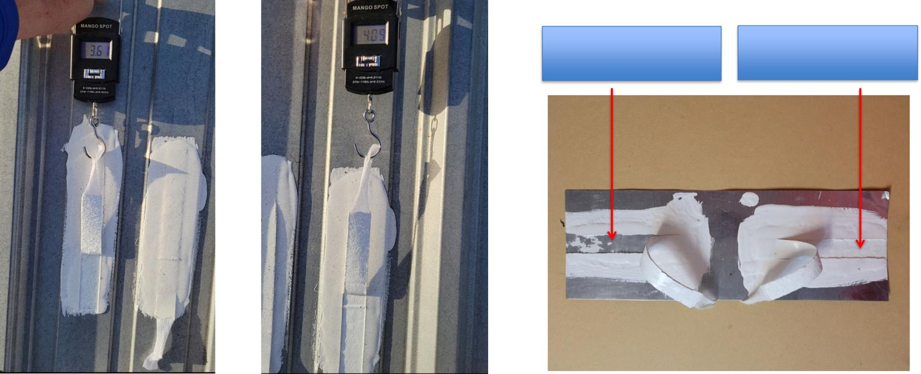
How to Do the Pull Test
SILICONE
Cut — slice along both sides of the test strip
Pull — lift it up and back, at 90° to 135°
Measure — it must hold at least 2.0 lbs per inch
Pass — the coating tears apart (cohesive)
Fail — the coating peels off clean (adhesive)
Notes:
KEY MESSAGE
Pass = the coating tears. Fail = it peels off clean.
SAY IT LIKE THIS
Left photos: the coating peeled off the roof clean. That's a fail. Right: the coating ripped inside itself and stayed stuck to the roof. That's a pass. It also has to hold at least 2 pounds per inch.
MAKE IT STICK
If the coating comes off clean like a sticker, it will come off in the wind, too.
ASK THE CREW
Hold up a sample or point at the photo: "Pass or fail?"
(Original deck: slide 35)

Slide 36
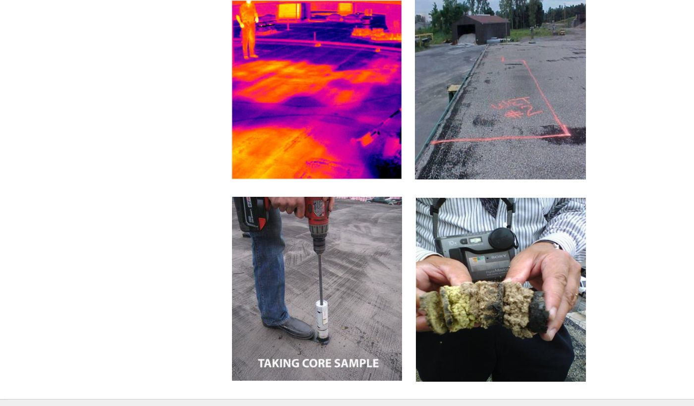
Step 3: Moisture Survey — Is It Wet Inside?
SILICONE
Find wet insulation — infrared scans and core cuts
More than 25% wet — not a candidate. Replace the roof.
Less than 25% wet — cut out the wet areas and replace them
Test methods — nuclear, infrared, impedance, or cores
You need — a roof map and NRCA guidelines
Not needed on metal roofs
Notes:
KEY MESSAGE
The 25% rule: more than a quarter wet means it's not a restoration job.
SAY IT LIKE THIS
You can't see wet insulation from the top. The scan finds it. If more than 25% of the roof is wet, we don't restore it. If it's less, we cut out the wet spots, replace them, and keep going.
MAKE IT STICK
Coating over wet insulation is like putting a new bandage over an infected cut. It looks fine — until it doesn't.
ASK THE CREW
"On a 100-square roof, how many squares can be wet and still be a candidate?" (Up to 25.)
(Original deck: slide 36)

Slide 37
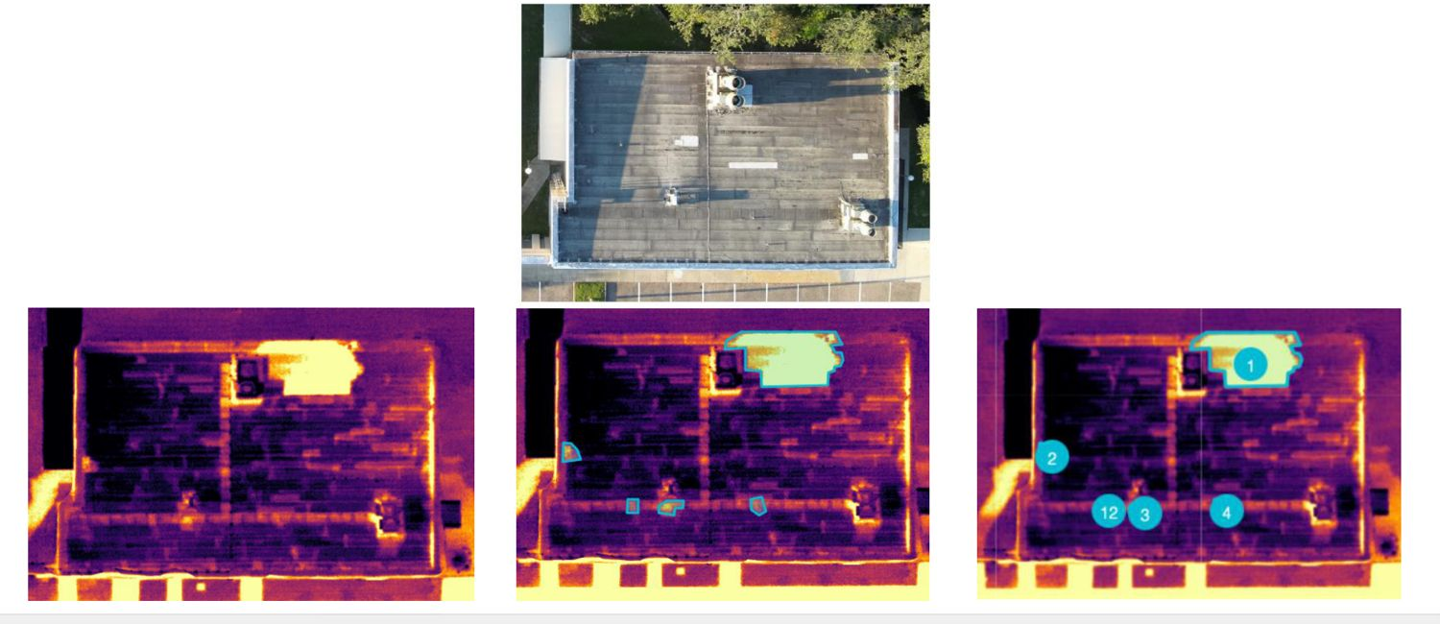
Drone Moisture Scan
SILICONE
Hot spots on the heat scan can mean trapped water under the roof.
Notes:
KEY MESSAGE
A drone heat scan shows wet areas you can't see from the roof.
SAY IT LIKE THIS
Wet insulation holds heat longer, so it shows up brighter on the scan. Each bright spot is a place to check with a core cut.
ASK THE CREW
"Where would you cut a core on this roof?"
(Original deck: slide 37)

Slide 38
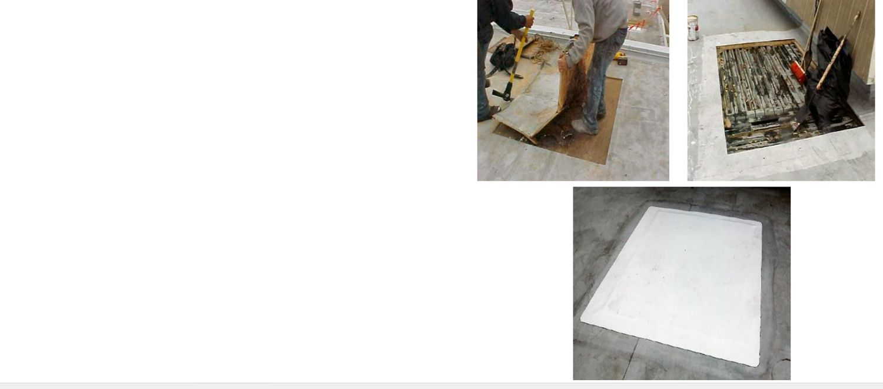
Step 4: Repair First, Then Restore
SILICONE
Replace wet insulation
Replace damaged deck
Fill damaged spots with matching roof material
The roof must be solid and watertight before you coat it
Notes:
KEY MESSAGE
Repair first, then restore. Coating does not fix a broken roof.
SAY IT LIKE THIS
Coating protects a roof. It doesn't fix one. Get the roof solid and dry first. Then coat it.
MAKE IT STICK
You don't paint over rotten wood. Same idea.
ASK THE CREW
"What's the worst thing you've seen someone coat over?"
(Original deck: slide 38)

Slide 39
Complete Line of Products
SILICONE
REMEMBER
One system, one brand — saves you time and money.
Notes:
KEY MESSAGE
Next: the silicone products, and what each one is for.
SAY IT LIKE THIS
Don't memorize numbers. Learn what job each product does.
(Original deck: slide 39)

Slide 40
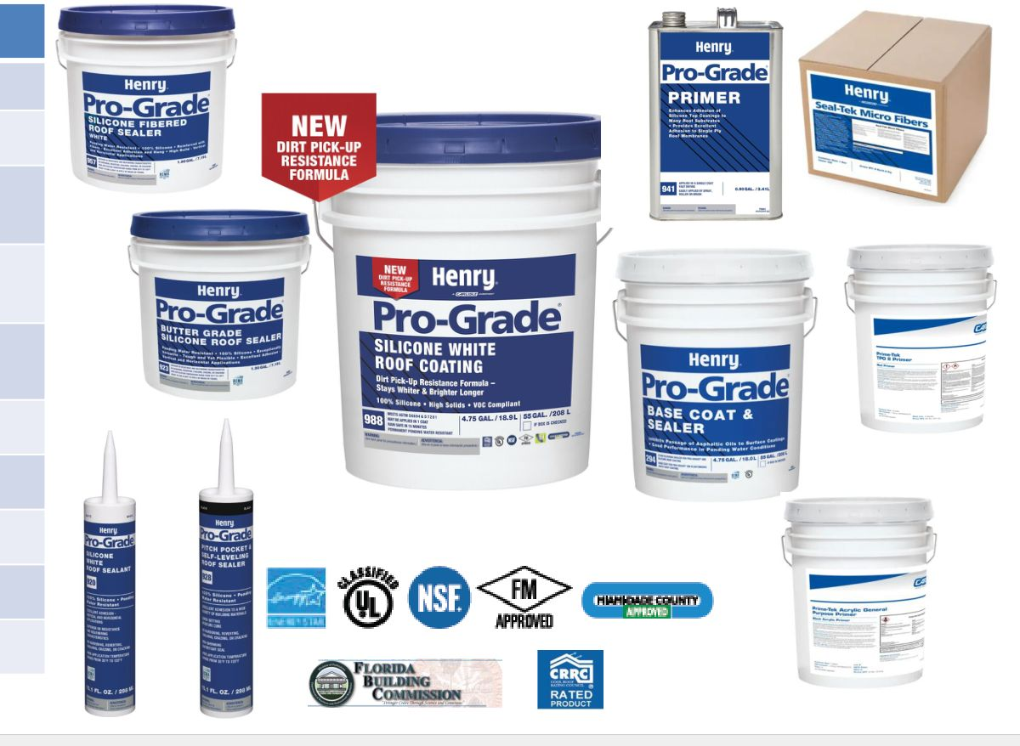
Silicone Product Lineup
SILICONE
Coating — Pro-Grade 988 Silicone
Sealers — 957 Fibered, 923 Butter Grade, 928 Pitch Pocket, 920 White
Reinforcement — Seal-Tek Micro Fibers
Basecoat — 294 Basecoat & Sealer
Primers — Prime-Tek TPO, Prime-Tek GP, 941 Adhesion
Notes:
KEY MESSAGE
One coating, four sealers, one basecoat, three primers. Everything you need for a silicone job.
SAY IT LIKE THIS
Group them by job: the coating covers the field, sealers do the details, the basecoat stops stains, primers help it stick.
ASK THE CREW
"Which product would you grab for a pipe boot?"
(Original deck: slide 40)

Slide 41
The 988 Silicone Difference
SILICONE
REMEMBER
One coat. Rain-safe in 15 minutes.
Notes:
KEY MESSAGE
Why 988 beats other silicones.
SAY IT LIKE THIS
Three things to remember about 988: one coat, often no primer, and rain-safe in 15 minutes.
(Original deck: slide 41)

Slide 42
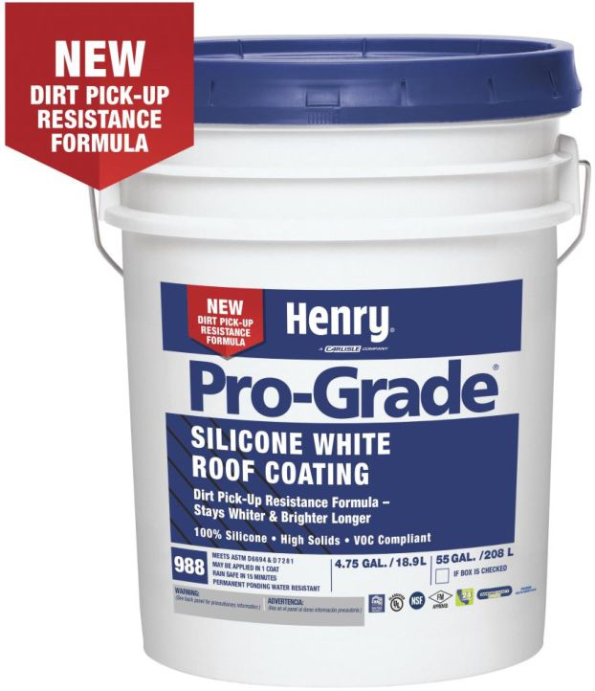
Pro-Grade 988: What It Is
SILICONE
Silicone rubber coating. No solvent.
Goes on asphalt, single-ply, metal, foam, and coated roofs
One coat — up to 50 mils
Usually no primer needed*
Rain-safe in 15 minutes
No fabric needed
Stays whiter longer — new dirt-resistant formula
Passes ASTM D7281 (water test)
*Do an adhesion test first. Over asphalt, use 294 Basecoat & Sealer to stop stains.
Notes:
KEY MESSAGE
988 saves you a trip: one coat, often no primer, no fabric.
SAY IT LIKE THIS
Most silicones need two coats. 988 goes on up to 50 mils in one pass. That's one less day on the roof. And if a storm pops up, it's rain-safe in 15 minutes.
MAKE IT STICK
50 mils is about the thickness of a credit card plus a bit. In one coat.
ASK THE CREW
"What does one coat instead of two save you on a 200-square roof?"
(Original deck: slide 42)

Slide 43

Pro-Grade 988: More Facts
SILICONE
No chalk filler — some brands are up to 50% chalk
Safe for rainwater collection (NSF P151)
Low fumes — under 10 g/L VOC
2-year shelf life — unopened, kept cool, dry, and shaded
White, gray, tan — premium and custom colors too
5-gal pail or 55-gal drum
Notes:
KEY MESSAGE
No cheap filler. Safe for rainwater. Long shelf life.
SAY IT LIKE THIS
Chalk is cheap filler. It makes a coating cheaper — and weaker. 988 has none.
MAKE IT STICK
Half-chalk silicone is like half-water coffee. Cheaper, but you notice.
(Original deck: slide 43)

Slide 44
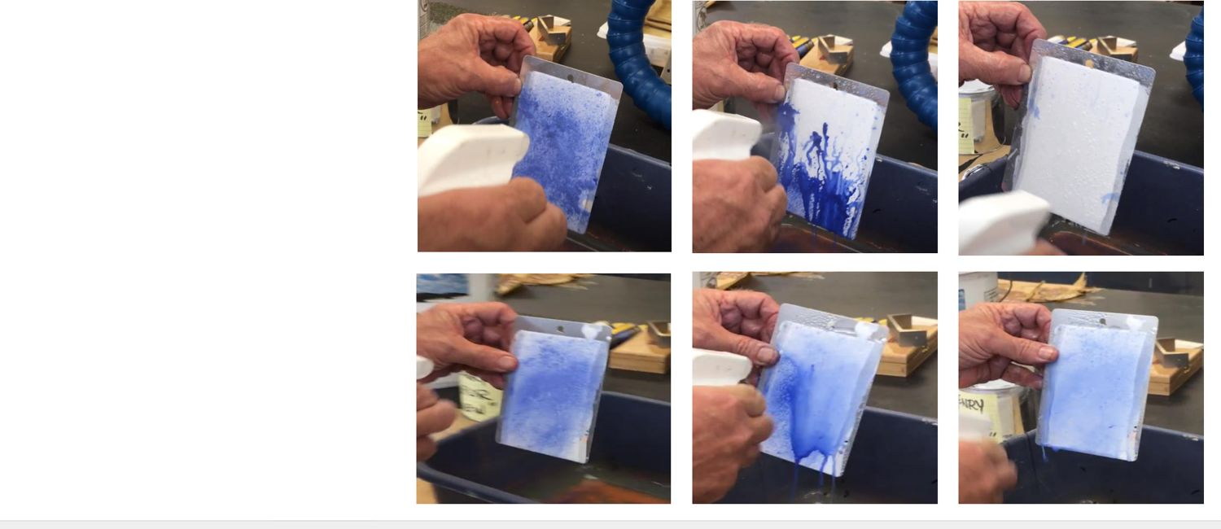
988 Stays Cleaner
SILICONE
Dirt test: Henry 988 vs. a competitor. Ours stays whiter, longer.
Notes:
KEY MESSAGE
A cleaner roof stays cooler and looks better to the owner.
SAY IT LIKE THIS
Silicone's weak spot is dirt. 988's new formula fights that. Point at the panels: same dirt, less staining on ours.
(Original deck: slide 44)

Slide 45
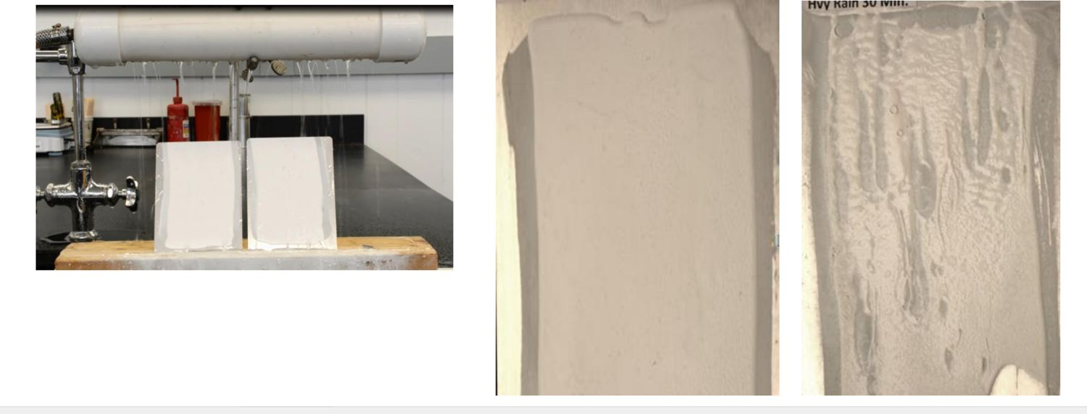
Rain Can't Wash It Off
SILICONE
Both dried 15 minutes, then 30 minutes of heavy rain. 988 held. The competitor didn't.
Notes:
KEY MESSAGE
Rain-safe in 15 minutes means a pop-up storm won't ruin your day.
SAY IT LIKE THIS
Left: 988 after rain — smooth. Right: the competitor — washed out. Ask: what does it cost you to redo a section after rain?
ASK THE CREW
"Ever lost a day's work to a surprise shower?"
(Original deck: slide 45)

Slide 46
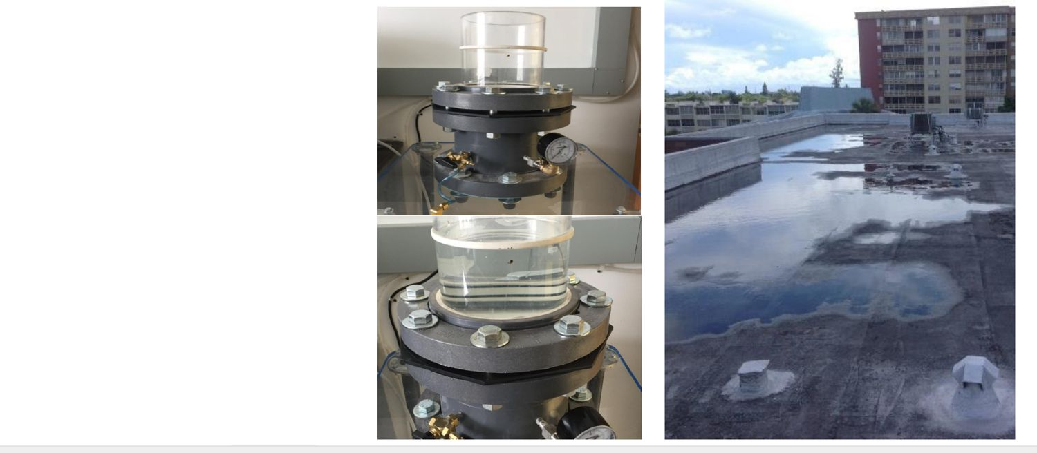
Why ASTM D7281 Matters
SILICONE
This test proves the coating is truly waterproof
Seals the leak spots — edges, pipes, and details
One seamless skin over the whole roof
Standing water can't get through
Notes:
KEY MESSAGE
D7281 is the proof: the coating keeps water out, even when it sits.
SAY IT LIKE THIS
You don't need to remember the test number. Remember what it means: water can sit on this coating and not get through.
MAKE IT STICK
Like a rain jacket vs. a sweatshirt. Both cover you. Only one keeps you dry.
(Original deck: slide 46)

Slide 47
Silicone Sealers & Primers
SILICONE
REMEMBER
Seal the details with the right product.
Notes:
KEY MESSAGE
The products that do the detail work.
SAY IT LIKE THIS
Remember — 90% of leaks start at the details. These are your detail tools.
(Original deck: slide 47)

Slide 48
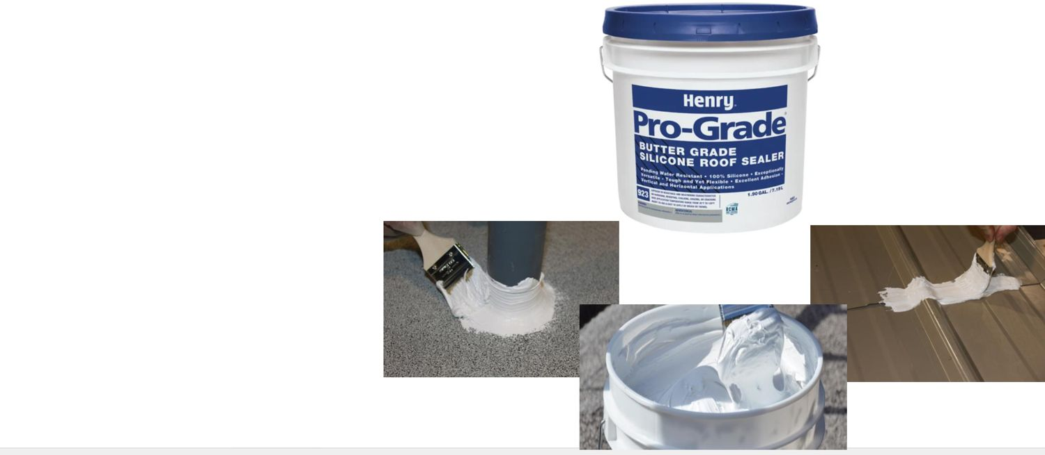
Pro-Grade 923 Butter Grade Silicone Sealer
SILICONE
Ready to use — no mixing
Tough and flexible
Brush, trowel, or spreader — up to 1/4" thick
Works on walls and flat areas
For pipes, flashings, seams, fasteners, repairs
White — 2-gal pail
Notes:
KEY MESSAGE
923 is thick like butter. Use it on details.
SAY IT LIKE THIS
Spreads like butter, stays where you put it. Good for walls and flat details up to a quarter inch thick.
(Original deck: slide 48)

Slide 49
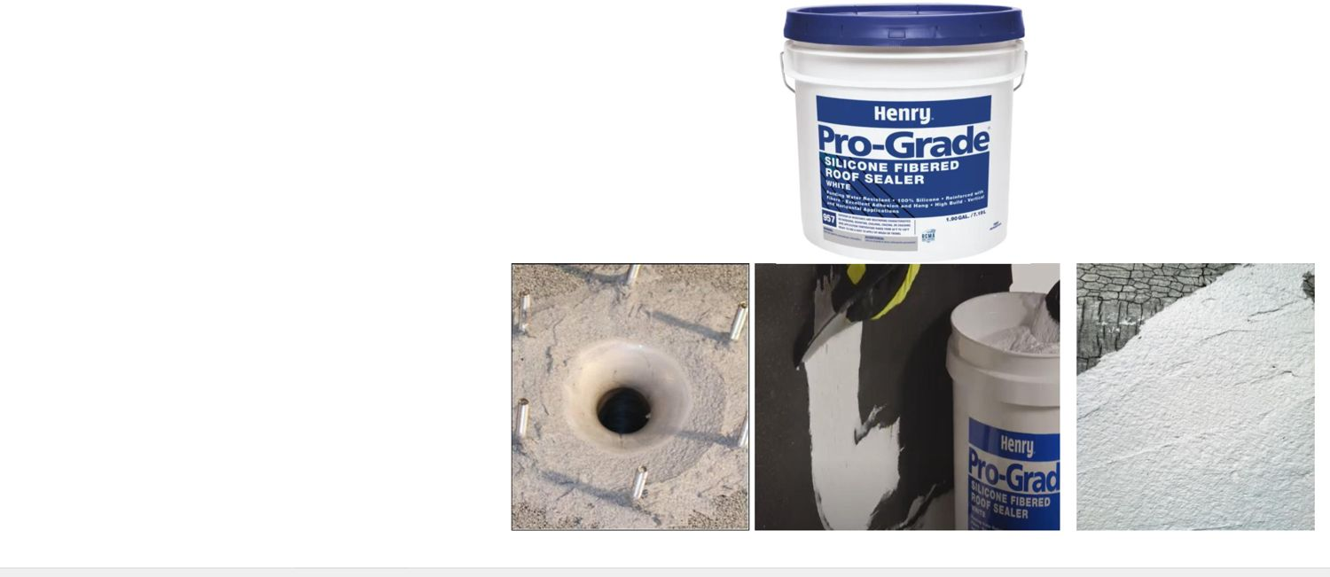
Pro-Grade 957 Fibered Silicone Sealer
SILICONE
Ready to use — no mixing
Fibers add strength
Trowel on — up to 1/2" thick
Works on walls and flat areas
For pipes, flashings, drains, seams, fasteners, repairs
White — 2-gal pail
Notes:
KEY MESSAGE
957 has fibers and goes on twice as thick as 923.
SAY IT LIKE THIS
When the gap is bigger, reach for 957. Fibers let it go on up to half an inch.
ASK THE CREW
"Gap is 3/8 inch. 923 or 957?" (957.)
(Original deck: slide 49)

Slide 50
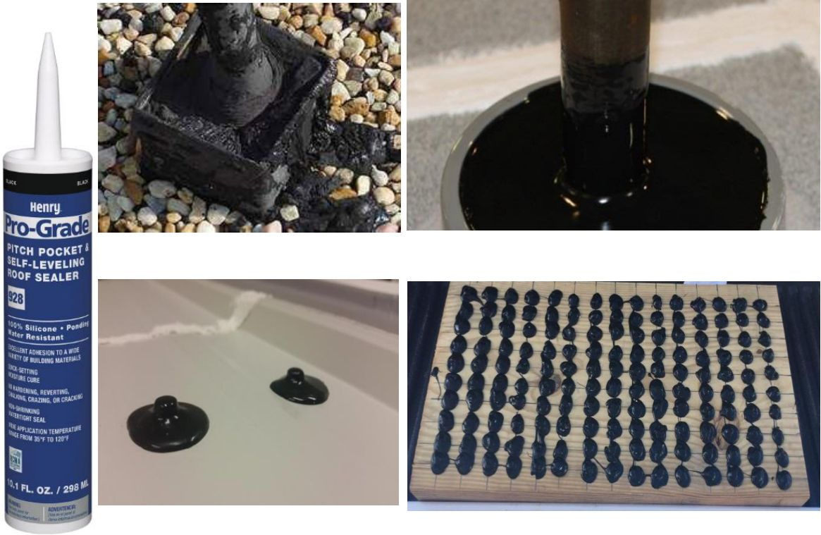
Pro-Grade 928 Pitch Pocket & Self-Leveling Sealer
SILICONE
Pours in and levels itself
Seals pipes in metal pitch pockets — no shrinking
Seals screws on low and medium-slope metal roofs
One tube seals about 100 fasteners (1/2")
No tooling needed — saves time
Black — 10.1 oz tube
Notes:
KEY MESSAGE
928 pours and levels itself. Great for pitch pockets and screw heads.
SAY IT LIKE THIS
Fill the pocket, walk away. No tooling. On metal roofs, a dab on each screw — about 100 screws per tube.
(Original deck: slide 50)

Slide 51
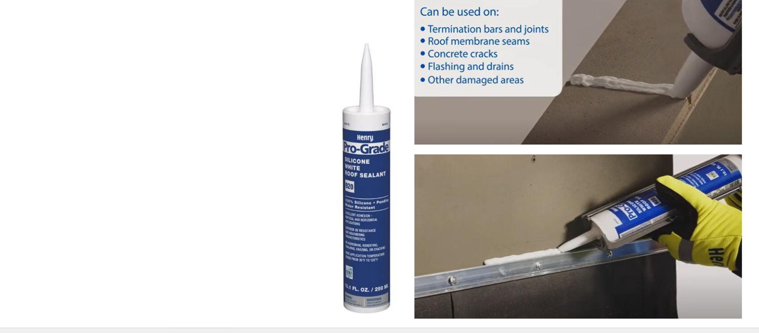
Pro-Grade 920 Silicone Roof Sealer
SILICONE
Silicone caulk that cures from moisture
Seals seams, concrete cracks, flashings, drains, and damage
One tube seals about 100 holes (1/2")
Won't harden, chalk, crack, or break down
White — 10.1 oz tube
Notes:
KEY MESSAGE
920 is the silicone caulk for small holes and cracks.
SAY IT LIKE THIS
Quick, clean fixes from a tube. About 100 half-inch holes per tube.
(Original deck: slide 51)

Slide 52
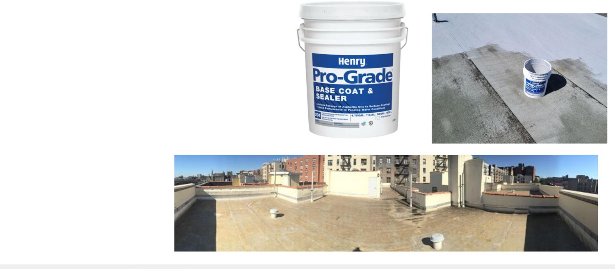
Pro-Grade 294 Basecoat & Sealer
SILICONE
Acrylic basecoat that blocks asphalt stains
Spray, roll, or brush
Always the first step on asphalt roofs!
Gray — 5-gal, 55-gal, 275-gal tote
Notes:
KEY MESSAGE
Asphalt roof? 294 goes on first. Every time.
SAY IT LIKE THIS
Asphalt oils bleed up and stain a white topcoat brown. 294 locks them in.
MAKE IT STICK
Like stain-blocking primer over a water spot on a ceiling. Skip it and the stain comes right back through.
ASK THE CREW
"What happens if you skip 294 on a mod-bit roof?" (Brown stains in the white silicone.)
(Original deck: slide 52)

Slide 53
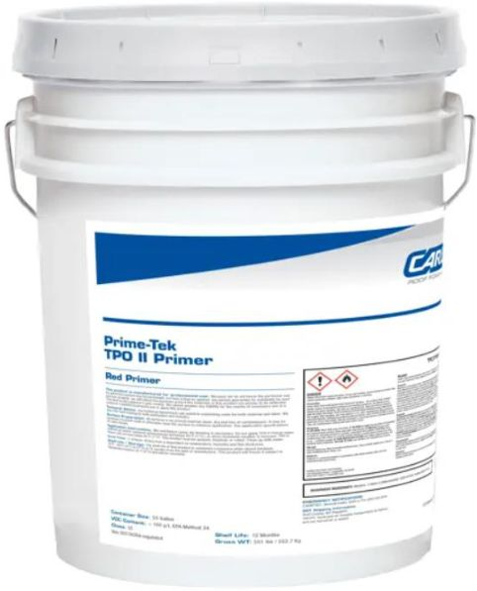
Prime-Tek TPO Primer
SILICONE
Helps coating stick to TPO roofs
For TPO only
Use under AcryShield acrylics and Pro-Grade 988 silicone
Dries fast. Low fumes (low VOC).
Red — 5-gal pail
Notes:
KEY MESSAGE
TPO is slick. This primer gives the coating something to grab.
SAY IT LIKE THIS
TPO is smooth and slippery — coatings have a hard time holding on. This red primer fixes that. It's only for TPO.
MAKE IT STICK
It's red, so you can see where you've been — no missed spots.
(Original deck: slide 53)

Slide 54
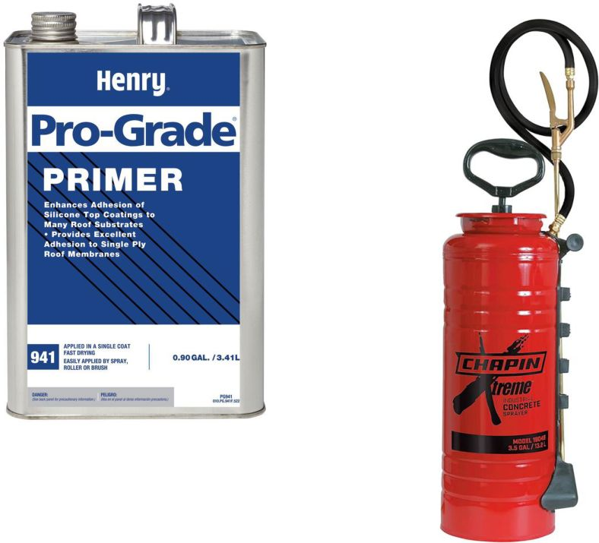
Pro-Grade 941 Adhesion Primer
SILICONE
Helps coating stick to single-ply, metal, and coated roofs
Dries fast
Spray (best), roll, or brush
Covers 400–600 sq ft per gallon
Clear / yellow — 1-gal can
Notes:
KEY MESSAGE
If the adhesion test says you need help, 941 is the help.
SAY IT LIKE THIS
Use 941 when the pull test comes back weak. Spray it thin — a gallon goes 400 to 600 square feet.
(Original deck: slide 54)

Slide 55
Project Startup
SILICONE
REMEMBER
A clean, dry roof is half the job.
Notes:
KEY MESSAGE
Prep: where good jobs are won or lost.
SAY IT LIKE THIS
Most coating failures start with bad prep. This section is short, but it matters most.
(Original deck: slide 55)

Slide 56
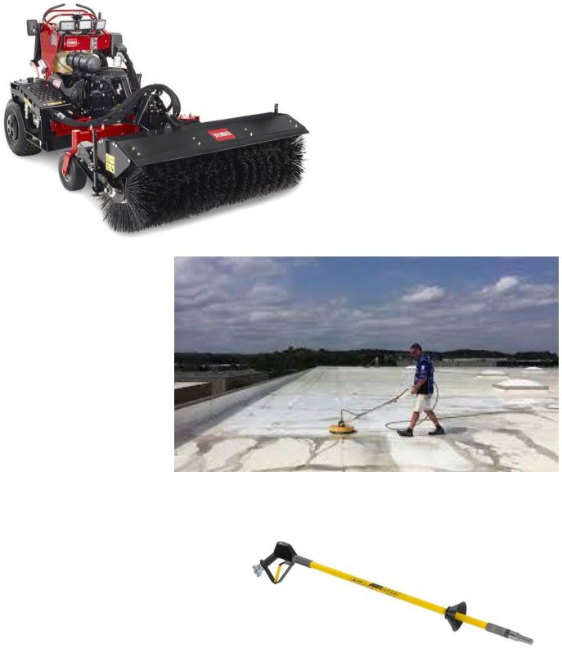
Prep Step 1: Clean the Roof
SILICONE
Mod-bit and BUR (granulated or smooth) — power broom, dry vac, air lance (195 CFM)
Single-ply — pressure wash at 1,500–2,000 PSI. Water only!
Metal — pressure wash at 3,000+ PSI. Water only! Air lance. Wire brush the rust.
Rule — all dirt gone and the roof DRY before any coating
Notes:
KEY MESSAGE
Coating sticks to whatever is on the roof. Make sure that's the roof — not dirt.
SAY IT LIKE THIS
Each roof type gets cleaned a little differently. Granulated and smooth asphalt: sweep, vacuum, blow it out. Single-ply and metal: pressure wash with plain water — no soap. Metal gets more pressure and a wire brush on rust. Then let it dry.
MAKE IT STICK
Paint on a dusty wall peels. Coating on a dirty roof peels. Most adhesion problems start right here.
ASK THE CREW
"Why water only — no soap?" (Soap leaves film behind, and coating won't stick to film.)
(Original deck: slide 56)

Slide 57
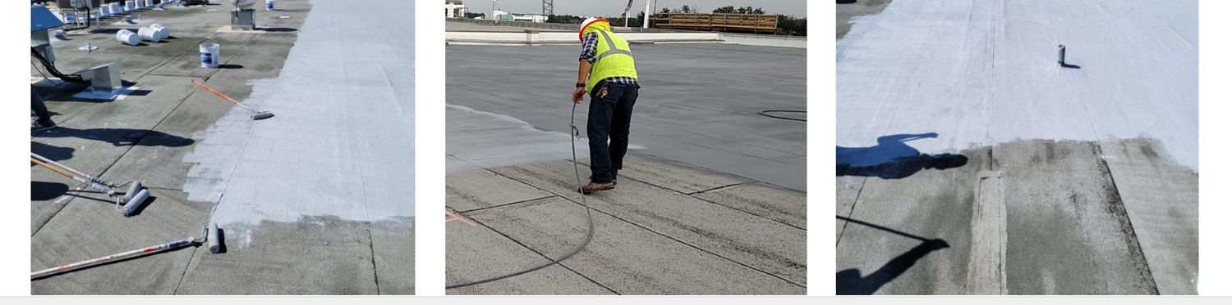
Prep Step 2: Basecoat Asphalt Roofs
SILICONE
For asphalt roofs, or roofs with an old aluminum coating
Apply Pro-Grade 294 Basecoat & Sealer
Roll, squeegee and back roll, spray and back roll, or tank spreader
Notes:
KEY MESSAGE
Asphalt or old aluminum? Basecoat with 294 before the silicone.
SAY IT LIKE THIS
Any method works. Just make sure it's covered evenly, with no bare spots.
(Original deck: slide 57)

Slide 58
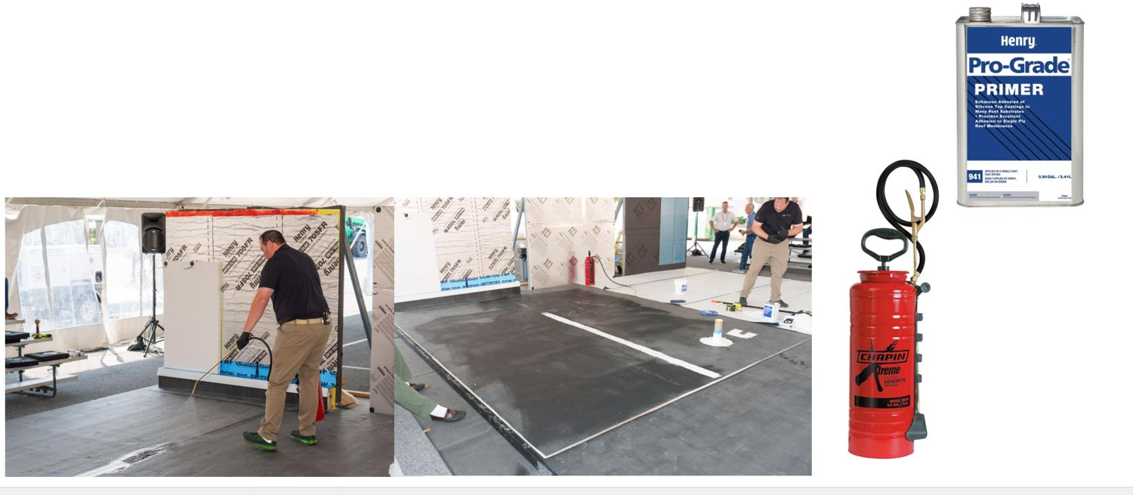
Prep Step 3: Prime If Needed
SILICONE
For single-ply, metal, and coated roofs
Use Pro-Grade 941 Adhesion Primer — if the pull test says so
Spray it — a Chapin Extreme pump sprayer works best
Notes:
KEY MESSAGE
The pull test decides if you prime. Don't guess.
SAY IT LIKE THIS
No need to prime everything. Test first. If the test is weak, prime.
(Original deck: slide 58)

Slide 59
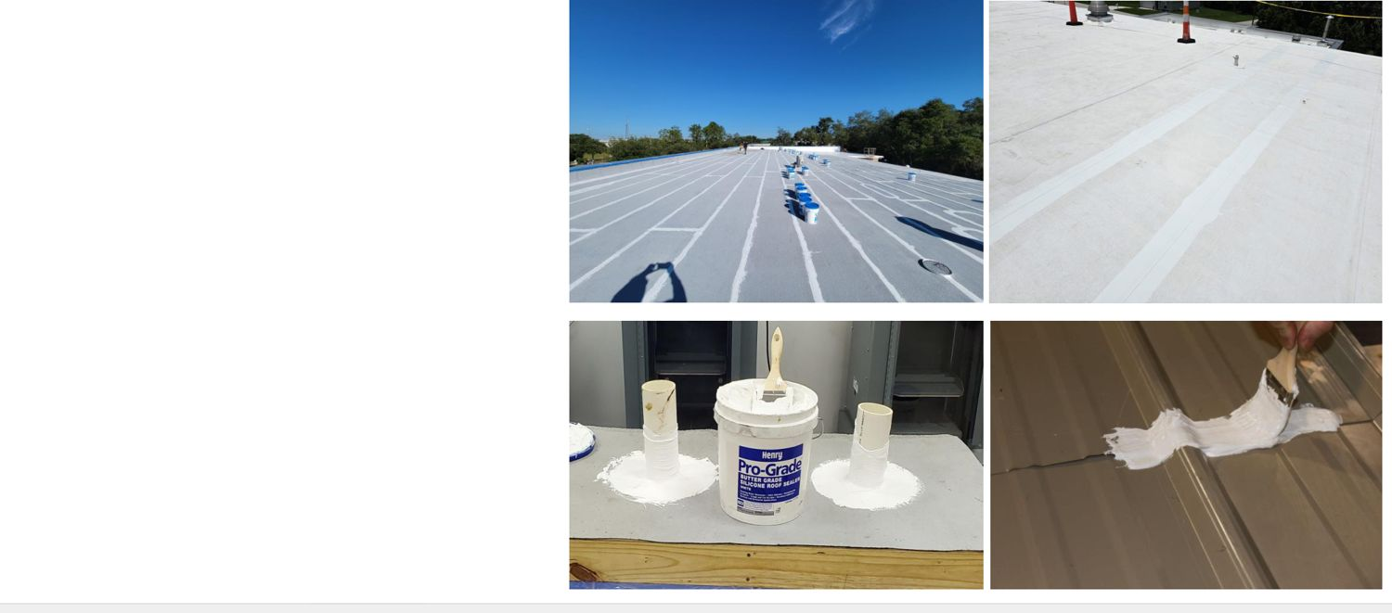
Sweat the Details
SILICONE
90%
of roof leaks start at these spots
Seams
Penetrations — pipes, vents, drains
Curbs
Edges (terminations)
Transitions — where the roof changes
Parapet walls
Notes:
KEY MESSAGE
90% of roof leaks start at these spots. Seal them first.
SAY IT LIKE THIS
Most of the roof is wide-open field. Leaks almost never start there. They start where something cuts through or changes. Do these first, and do them right.
MAKE IT STICK
A boat doesn't sink through the middle of the hull. It leaks at the seams and the holes.
ASK THE CREW
"Name the last leak you chased. Where was it?" (It's almost always one of these.)
(Original deck: slide 59)

Slide 60
Which Product for Which Detail?
SILICONE
Roof | Detail | Product → How
Asphalt / single-ply | Seams | 988 → brush, roll, spray 923 → brush, trowel 957 → trowel
Asphalt / single-ply | Pipes and drains | 923 → brush, trowel 957 → trowel
Metal | Seams, pipes, fasteners | 923 → brush, trowel 957 → trowel 928 → caulk gun
Notes:
KEY MESSAGE
Match the product to the detail.
SAY IT LIKE THIS
Hand out this chart. It's a cheat sheet. Go row by row: roof type, the detail, the product to use.
ASK THE CREW
"Metal roof, a hundred screw heads. What's fastest?" (928 from a caulk gun.)
(Original deck: slide 60)

Slide 61
Silicone Application
SILICONE
REMEMBER
Measure the squares. Hit the rate.
Notes:
KEY MESSAGE
Putting the coating down.
SAY IT LIKE THIS
Two things decide a good application: the right amount and even coverage. The grid gets you both.
(Original deck: slide 61)

Slide 62
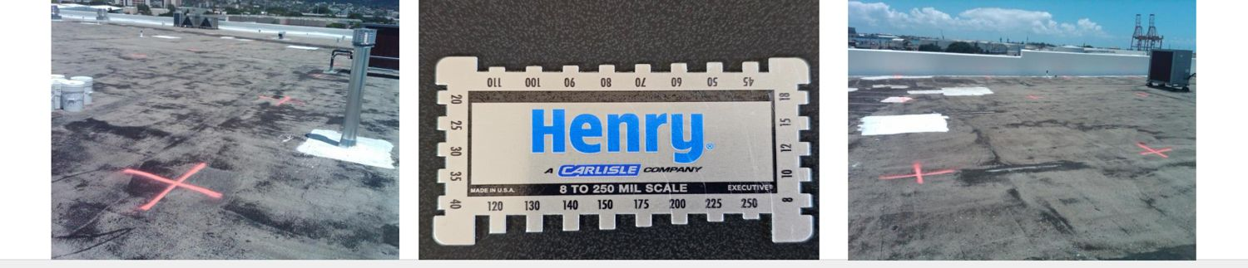
Measure the Roof in Squares
SILICONE
Mark the roof in 10' × 10' boxes — 1 box = 1 square = 100 sq ft
Example — spec says 2 gal per square → one 5-gal pail of 988 covers 2.38 squares (smooth roof)
Rough roofs (granulated mod-bit) soak up more — use more to hit the right dry thickness
Notes:
KEY MESSAGE
Mark the squares. Count the pails. Hit the rate.
SAY IT LIKE THIS
Chalk out 10 by 10 boxes. Each box is one square. Now you know exactly how many pails each area needs, and nobody runs thin. Rough roofs eat more coating, so plan for extra.
MAKE IT STICK
A 10' × 10' square is about the size of a small bedroom. Picture filling that room's floor with the right number of gallons.
ASK THE CREW
"Spec is 2 gallons a square. You have 10 squares. How many gallons?" (20.)
(Original deck: slide 62)

Slide 63
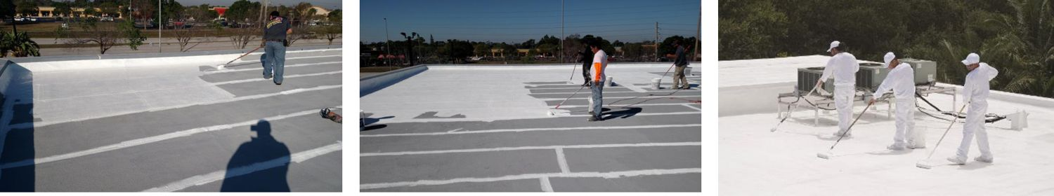
Ways to Apply: Roll
SILICONE
Roll it on in even passes. Good for small roofs and edges.
Notes:
KEY MESSAGE
Roll is one of the ways to put this coating down.
SAY IT LIKE THIS
Walk through the photo. Roll it on in even passes. Good for small roofs and edges. Pick the method that fits the roof size, the crew, and the weather.
ASK THE CREW
"Who here has used this method? Any tips for the new folks?"
(Original deck: slide 63)

Slide 64
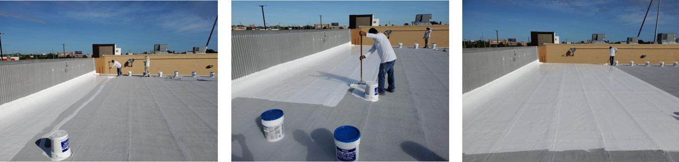
Ways to Apply: Squeegee and Back Roll
SILICONE
Pour, spread with a squeegee, then roll to even it out.
Notes:
KEY MESSAGE
Squeegee and Back Roll is one of the ways to put this coating down.
SAY IT LIKE THIS
Walk through the photo. Pour, spread with a squeegee, then roll to even it out. Pick the method that fits the roof size, the crew, and the weather.
ASK THE CREW
"Who here has used this method? Any tips for the new folks?"
(Original deck: slide 64)

Slide 65
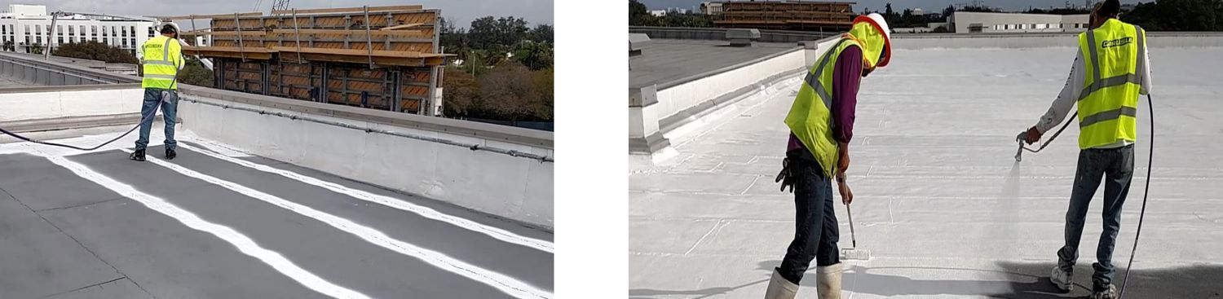
Ways to Apply: Spray and Back Roll
SILICONE
Spray for speed, then roll to push it into the surface.
Notes:
KEY MESSAGE
Spray and Back Roll is one of the ways to put this coating down.
SAY IT LIKE THIS
Walk through the photo. Spray for speed, then roll to push it into the surface. Pick the method that fits the roof size, the crew, and the weather.
ASK THE CREW
"Who here has used this method? Any tips for the new folks?"
(Original deck: slide 65)

Slide 66
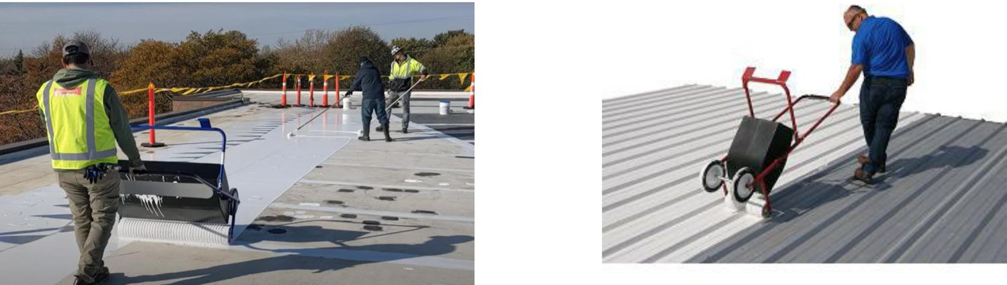
Ways to Apply: Tank Spreader
SILICONE
Walk-behind spreader puts down an even coat on big, open areas.
Notes:
KEY MESSAGE
Tank Spreader is one of the ways to put this coating down.
SAY IT LIKE THIS
Walk through the photo. Walk-behind spreader puts down an even coat on big, open areas. Pick the method that fits the roof size, the crew, and the weather.
ASK THE CREW
"Who here has used this method? Any tips for the new folks?"
(Original deck: slide 66)

Slide 67
Warranty Information
SILICONE
REMEMBER
Do it right, and Henry stands behind it — up to 20 years.
Notes:
KEY MESSAGE
What the silicone warranty covers.
SAY IT LIKE THIS
This is what the owner is really buying: years of peace of mind.
(Original deck: slide 67)

Slide 68

Henry Warranty Program
SILICONE
Up to 20 years — labor, workmanship, and materials
Can be transferred and renewed
Silicone — ponding water is NOT excluded*
Silicone — lifetime limited material warranty
*Puddles, not lakes. The roof must still drain.
Notes:
KEY MESSAGE
Up to 20 years, and ponding water is covered on silicone.
SAY IT LIKE THIS
Most warranties say "no coverage where water ponds." Ours doesn't — on silicone. That's a big selling point.
MAKE IT STICK
Tell the owner: "Even where water sits, you're covered."
(Original deck: slide 68)

Slide 69
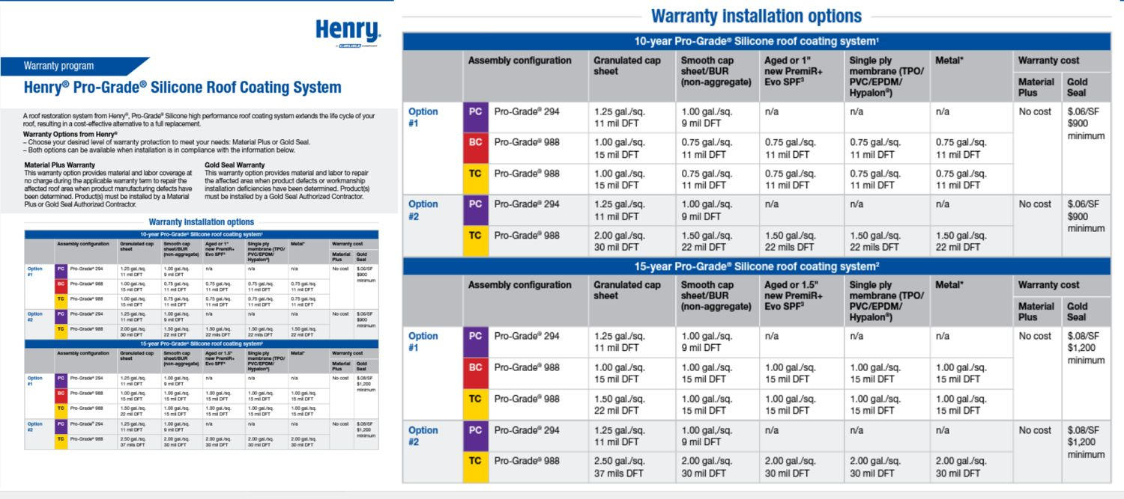
Silicone Warranty Options
SILICONE
Pick the warranty length. The chart tells you how much coating and how many coats you need.
Notes:
KEY MESSAGE
Longer warranty = more coating. The chart tells you exactly how much.
SAY IT LIKE THIS
Don't read this chart out loud. Show how to use it: find the roof type, find the warranty years, read across to the rate. Hand out the printed chart so the crew can follow along.
ASK THE CREW
"Find the rate for a 10-year warranty on a smooth asphalt roof." Let them find it.
(Original deck: slide 69)

Slide 70

Silicone Warranty Options
SILICONE
Pick the warranty length. The chart tells you how much coating and how many coats you need.
Notes:
KEY MESSAGE
Longer warranty = more coating. The chart tells you exactly how much.
SAY IT LIKE THIS
Don't read this chart out loud. Show how to use it: find the roof type, find the warranty years, read across to the rate. Hand out the printed chart so the crew can follow along.
ASK THE CREW
"Find the rate for a 10-year warranty on a smooth asphalt roof." Let them find it.
(Original deck: slide 70)

Slide 71

Silicone Application Guide
SILICONE
Your step-by-step guide for this system. Keep it on the job.
Notes:
KEY MESSAGE
The application guide is the rulebook. When in doubt, check the guide.
SAY IT LIKE THIS
This is the reference sheet for the whole system: prep, primers, rates, and cure times. Print it. Keep it in the truck.
(Original deck: slide 71)

Slide 72
AcryShield Acrylic System
ACRYLIC
REMEMBER
Acrylic: great value on roofs that drain well.
Notes:
KEY MESSAGE
Section 2 of 4: Acrylic.
SAY IT LIKE THIS
Acrylic is the budget-friendly workhorse. Great on sloped roofs and metal. The catch: it hates standing water.
(Original deck: slide 72)

Slide 73

Acrylic: The Strengths
ACRYLIC
Flexible and stretchy
Sticks well
Easy to apply — spray, brush, or roll
Breathes — lets moisture vapor escape
Other coatings can go over it later
Good value. Low fumes.
Notes:
KEY MESSAGE
Acrylic is easy, affordable, and flexible.
SAY IT LIKE THIS
Easy to put down, easy to clean up, and you can coat over it later with almost anything.
(Original deck: slide 73)

Slide 74

Acrylic: The Downsides
ACRYLIC
Standing water softens it
Needs 2 or more coats
Weather matters — 50°F and rising, no rain for 24+ hours
Can wash off if it rains too soon
Takes longer to cure
Mold and mildew can grow on it
Loses about 1–2 mils a year to sun. Only about 50% solids.
There are 380+ acrylic brands. Many use cheaper ingredients (styrene, vinyl).
Notes:
KEY MESSAGE
Acrylic needs warm, dry weather and a roof that drains.
SAY IT LIKE THIS
Water-based means rain is its enemy until it cures. Watch the forecast. And half of what's in the bucket evaporates — that's why it takes more coats.
MAKE IT STICK
Acrylic is like latex house paint. Great stuff — but you don't paint in the rain.
ASK THE CREW
"Forecast says rain in 18 hours. Do you spray acrylic today?" (No — it needs 24.)
(Original deck: slide 74)

Slide 75

When Acrylic Is a Good Fit
ACRYLIC
Steep roofs — 3:12 or more
Metal roofs
Flat roofs* — only in dry areas with great drainage
Barrel (curved) roofs
Hot, dry climates
Little disruption. Budget-friendly.
*Areas with little rain and good drainage — no ponding water.
Notes:
KEY MESSAGE
Sloped, metal, curved, or dry climates: think acrylic.
SAY IT LIKE THIS
Notice this is the opposite of silicone. Where silicone runs off, acrylic holds.
(Original deck: slide 75)

Slide 76

When Acrylic Is NOT a Good Fit
ACRYLIC
Ponding water
Flat roofs* that don't drain
Heavy foot traffic
Max sun protection needed
Lots of freeze-thaw cycles
*Little to no drainage.
Notes:
KEY MESSAGE
Standing water and acrylic don't mix.
SAY IT LIKE THIS
If water sits on the roof after a rain, acrylic will soften and fail. Pick silicone instead.
ASK THE CREW
"Flat roof in Florida with ponding. Acrylic or silicone?" (Silicone.)
(Original deck: slide 76)

Slide 77
What Roofs Can Acrylic Restore?
ACRYLIC
REMEMBER
Same roof types — except old silicone.
Notes:
KEY MESSAGE
Quick photo tour, same as silicone.
SAY IT LIKE THIS
Have the crew name each roof type before you click.
(Original deck: slide 77)

Slide 78
Asphalt Roofs
ACRYLIC
Granulated or smooth mod-bit, and BUR (built-up roof).
Notes:
KEY MESSAGE
Review: asphalt roof types.
SAY IT LIKE THIS
We covered this already. Don't re-teach it. Ask the crew to explain it to you, then fill in anything they miss.
ASK THE CREW
"Who can walk us through this one?" Let them talk first.
(Original deck: slide 78)

Slide 79

Single-Ply Roofs
ACRYLIC
PVC, TPO, and EPDM.
Notes:
KEY MESSAGE
Review: single-ply roof types.
SAY IT LIKE THIS
We covered this already. Don't re-teach it. Ask the crew to explain it to you, then fill in anything they miss.
ASK THE CREW
"Who can walk us through this one?" Let them talk first.
(Original deck: slide 79)

Slide 80

Metal Roofs
ACRYLIC
Standing seam and screw-down metal.
Notes:
KEY MESSAGE
Review: metal roofs.
SAY IT LIKE THIS
We covered this already. Don't re-teach it. Ask the crew to explain it to you, then fill in anything they miss.
ASK THE CREW
"Who can walk us through this one?" Let them talk first.
(Original deck: slide 80)

Slide 81
Spray Foam (SPF) Roofs
ACRYLIC
Acrylic protects foam from the sun.
Notes:
KEY MESSAGE
Review: spray foam roofs.
SAY IT LIKE THIS
We covered this already. Don't re-teach it. Ask the crew to explain it to you, then fill in anything they miss.
ASK THE CREW
"Who can walk us through this one?" Let them talk first.
(Original deck: slide 81)

Slide 82

Roofs Coated Before
ACRYLIC
Yes — except roofs coated with silicone.
Notes:
KEY MESSAGE
Acrylic can't go over silicone.
SAY IT LIKE THIS
Remember: only silicone sticks to silicone. Acrylic goes over almost any other old coating.
ASK THE CREW
"Why can't acrylic go over silicone?"
(Original deck: slide 82)

Slide 83

Tar & Gravel Roofs
ACRYLIC
Not ready as-is (red X). The gravel has to be dealt with first.
Notes:
KEY MESSAGE
Review: tar and gravel roofs.
SAY IT LIKE THIS
We covered this already. Don't re-teach it. Ask the crew to explain it to you, then fill in anything they miss.
ASK THE CREW
"Who can walk us through this one?" Let them talk first.
(Original deck: slide 83)

Slide 84
Tar & Gravel + Spray Foam
ACRYLIC
Spray foam over the old gravel roof, then coat it.
Notes:
KEY MESSAGE
Review: tar and gravel with spray foam.
SAY IT LIKE THIS
We covered this already. Don't re-teach it. Ask the crew to explain it to you, then fill in anything they miss.
ASK THE CREW
"Who can walk us through this one?" Let them talk first.
(Original deck: slide 84)

Slide 85
Acrylic Restoration Steps
ACRYLIC
REMEMBER
Repair first, then restore.
Notes:
KEY MESSAGE
Review: the restoration steps — same as silicone.
SAY IT LIKE THIS
We covered this already. Don't re-teach it. Ask the crew to explain it to you, then fill in anything they miss.
ASK THE CREW
"Who can walk us through this one?" Let them talk first.
(Original deck: slide 85)

Slide 86
The Steps for a Warranted Job
ACRYLIC
1
2
3
Walk the roof
Adhesion test
Moisture survey
Look it over. (If needed)
Will the coating stick? (If needed)
Is it wet inside? (If needed)
4
5
6
Fix the roof
Restore
Final inspection
Repair what's broken
Apply the coating system
Check the work. (If needed)
Notes:
KEY MESSAGE
Review: the six steps of a warranted job.
SAY IT LIKE THIS
We covered this already. Don't re-teach it. Ask the crew to explain it to you, then fill in anything they miss.
ASK THE CREW
"Who can walk us through this one?" Let them talk first.
(Original deck: slide 86)

Slide 87

Step 1: Walk the Roof
ACRYLIC
Best done with a Henry rep
It's free — no charge
We just need a way onto the roof
Notes:
KEY MESSAGE
Review: the roof walk — free, with a Henry rep.
SAY IT LIKE THIS
We covered this already. Don't re-teach it. Ask the crew to explain it to you, then fill in anything they miss.
ASK THE CREW
"Who can walk us through this one?" Let them talk first.
(Original deck: slide 87)

Slide 88
Step 2: Adhesion Test — Will It Stick?
ACRYLIC
Checks that the coating will stick to this roof
Required on — single-ply, metal, smooth asphalt, and roofs coated before
Best result — the coating tears before it lets go (called "cohesive failure")
Notes:
KEY MESSAGE
Review: the adhesion test and what a good result looks like.
SAY IT LIKE THIS
We covered this already. Don't re-teach it. Ask the crew to explain it to you, then fill in anything they miss.
ASK THE CREW
"Who can walk us through this one?" Let them talk first.
(Original deck: slide 88)

Slide 89
How to Do the Pull Test
ACRYLIC
Cut — slice along both sides of the test strip
Pull — lift it up and back, at 90° to 135°
Measure — it must hold at least 2.0 lbs per inch
Pass — the coating tears apart (cohesive)
Fail — the coating peels off clean (adhesive)
Notes:
KEY MESSAGE
Review: how to run the pull test — cut, pull, measure.
SAY IT LIKE THIS
We covered this already. Don't re-teach it. Ask the crew to explain it to you, then fill in anything they miss.
ASK THE CREW
"Who can walk us through this one?" Let them talk first.
(Original deck: slide 89)

Slide 90
Step 3: Moisture Survey — Is It Wet Inside?
ACRYLIC
Find wet insulation — infrared scans and core cuts
More than 25% wet — not a candidate. Replace the roof.
Less than 25% wet — cut out the wet areas and replace them
Test methods — nuclear, infrared, impedance, or cores
You need — a roof map and NRCA guidelines
Not needed on metal roofs
Notes:
KEY MESSAGE
Review: the moisture survey and the 25% rule.
SAY IT LIKE THIS
We covered this already. Don't re-teach it. Ask the crew to explain it to you, then fill in anything they miss.
ASK THE CREW
"Who can walk us through this one?" Let them talk first.
(Original deck: slide 90)

Slide 91
Drone Moisture Scan
ACRYLIC
Hot spots on the heat scan can mean trapped water under the roof.
Notes:
KEY MESSAGE
Review: drone heat scans.
SAY IT LIKE THIS
We covered this already. Don't re-teach it. Ask the crew to explain it to you, then fill in anything they miss.
ASK THE CREW
"Who can walk us through this one?" Let them talk first.
(Original deck: slide 91)

Slide 92
Step 4: Repair First, Then Restore
ACRYLIC
Replace wet insulation
Replace damaged deck
Fill damaged spots with matching roof material
The roof must be solid and watertight before you coat it
Notes:
KEY MESSAGE
Review: repair first, then restore.
SAY IT LIKE THIS
We covered this already. Don't re-teach it. Ask the crew to explain it to you, then fill in anything they miss.
ASK THE CREW
"Who can walk us through this one?" Let them talk first.
(Original deck: slide 92)

Slide 93
Complete Line of Products
ACRYLIC
REMEMBER
One system, one brand — saves you time and money.
Notes:
KEY MESSAGE
The acrylic products.
SAY IT LIKE THIS
Same idea as silicone: group them by job.
(Original deck: slide 93)

Slide 94

AcryShield Product Lineup
ACRYLIC
Topcoats — 510, 610 Fast-Set, 550 High Tensile, 400
Basecoats — 505, 605 Fast-Set, 501 SPF
Asphalt base — Pro-Grade 197 Emulsion
Primer — Prime-Tek TPO
Sealants — 289 White, 295 Metal Seam
Reinforcement — Seal-Tek Micro Fibers, 195/196 Fabric
Notes:
KEY MESSAGE
Basecoat + topcoat + sealants + fabric = a complete acrylic system.
SAY IT LIKE THIS
Pro-Grade 280 and 294 are still available for older specs that call for them.
(Original deck: slide 94)

Slide 95
AcryShield Topcoats
ACRYLIC
REMEMBER
Pick the topcoat by the job.
Notes:
KEY MESSAGE
Four topcoats. Each fits a different job.
SAY IT LIKE THIS
Standard, fast, tough, or multi-purpose. That's the whole decision.
(Original deck: slide 95)

Slide 96
Choosing a Topcoat
ACRYLIC
Topcoat | Best for
510 | The standard, go-to topcoat
610 Fast-Set | Fast-setting — handles heavy dew and light rain
550 High Tensile | Toughest and stretchiest. Highest reflectivity (SRI).
400 | Multi-purpose topcoat
All four: meet codes. White, sand, light gray, dark gray. 5-gal and 55-gal drums.
Notes:
KEY MESSAGE
Standard → 510. Weather risk → 610. Tough job → 550. All-around → 400.
SAY IT LIKE THIS
All four meet codes, come in white, sand, light gray, and dark gray, in 5- and 55-gallon sizes.
ASK THE CREW
"Job near the coast with morning fog. Which topcoat?" (610 Fast-Set.)
(Original deck: slide 96)

Slide 97

NEW: AcryShield 250 Elastomeric Coating
ACRYLIC
Budget topcoat or basecoat
CRRC rated. Meets Title 24.
White — 5-gal, 55-gal
Material warranty ONLY
No Material Plus or Gold Seal warranties
Notes:
KEY MESSAGE
250 is the low-cost option — but it only gets a material warranty.
SAY IT LIKE THIS
Good for price-driven jobs. Be clear with the owner: no labor coverage with this one.
ASK THE CREW
"Owner wants a Gold Seal warranty. Can you use 250?" (No.)
(Original deck: slide 97)

Slide 98
AcryShield Basecoats, Accessories & Primers
ACRYLIC
REMEMBER
The basecoat is the foundation.
Notes:
KEY MESSAGE
What goes under the topcoat.
SAY IT LIKE THIS
A good basecoat stops stains and helps everything stick.
(Original deck: slide 98)

Slide 99
Choosing a Basecoat
ACRYLIC
Basecoat | Best for
505 | The standard. Blocks stains, sticks great. Buff.
605 Fast-Set | Handles heavy dew and light rain. Blocks stains. Buff.
400 | Blocks stains. White, sand, light and dark gray.
Pro-Grade 294 | For specs that use Pro-Grade 280. Blocks stains. Medium gray.
505, 605, 400: 5-gal and 55-gal. 294: 5-gal, 55-gal, 275-gal tote.
Notes:
KEY MESSAGE
Standard → 505. Weather risk → 605.
SAY IT LIKE THIS
Same pattern as the topcoats: there's a standard and a fast-set version.
(Original deck: slide 99)

Slide 100
Prime-Tek TPO Primer
ACRYLIC
Helps coating stick to TPO roofs
For TPO only
Use under AcryShield acrylics and Pro-Grade 988 silicone
Dries fast. Low fumes (low VOC).
Red — 5-gal pail
Notes:
KEY MESSAGE
Review: Prime-Tek TPO primer — TPO only.
SAY IT LIKE THIS
We covered this already. Don't re-teach it. Ask the crew to explain it to you, then fill in anything they miss.
ASK THE CREW
"Who can walk us through this one?" Let them talk first.
(Original deck: slide 100)

Slide 101

Pro-Grade 197 Asphalt Emulsion
ACRYLIC
Cold-applied coating for asphalt roofs
Keeps water out and smooths rough spots
Adds life to the old roof
Low odor. Meets VOC rules everywhere.
Must be topcoated — with acrylic or aluminum
Black — 5-gal, 55-gal, 275-gal tote, bulk
Notes:
KEY MESSAGE
197 is the black base layer. It always needs a topcoat.
SAY IT LIKE THIS
This is a cold asphalt coating. No kettle, no torch. It fills and levels the old asphalt. But the sun breaks it down, so it must be covered with acrylic or aluminum.
MAKE IT STICK
Think of 197 as primer on a car. It's important — but you'd never leave the car in primer.
(Original deck: slide 101)

Slide 102

Henry 295 Metal Seam Sealer
ACRYLIC
Rubber-based (SEBS) sealant for metal roofs
Strong and stretchy
For seams that move less than 1/8"
No fabric needed
Can be coated over — water-based, solvent-based, or aluminum coatings
Brush, pump spray, or bulk gun
Off-white — 5-gal pail
Notes:
KEY MESSAGE
295 seals metal seams and screws — no fabric needed.
SAY IT LIKE THIS
Metal roofs move with heat and cold. This sealer moves with them. Use it on seams, fasteners, penetrations, and flashings. Seams must move less than an eighth of an inch.
ASK THE CREW
"How do you know if a seam moves more than 1/8 inch?"
(Original deck: slide 102)

Slide 103

Henry 289 White Roof Sealant
ACRYLIC
Acrylic patching compound
Use on dry or damp roofs — not wet
Ready to use. Skins over fast.
Won't bleed through white coatings
Trowel or brush — up to 1/4" thick
For pipes, flashings, drains, seams, fasteners, repairs
White — 3.5-gal, 1-gal, 10.1 oz tube
Notes:
KEY MESSAGE
289 is the white patch for acrylic jobs. Damp is OK. Wet is not.
SAY IT LIKE THIS
Use it to patch and seal details before the acrylic goes on. It stays white, so it won't stain your topcoat.
ASK THE CREW
"What's the difference between damp and wet?" (Damp: dark but no standing water. Wet: you can see water.)
(Original deck: slide 103)

Slide 104

Henry 195 / 196 Polyester Fabric
ACRYLIC
195 — soft. Bends around odd shapes.
196 — firmer.
Both — strong stitched polyester
For drains, seams, and repairs
195 rolls — 40" × 324', 12" × 300', 6" × 300'
196 rolls — 40" × 324', 4" × 300'
Notes:
KEY MESSAGE
Fabric adds strength where the roof moves or cracks.
SAY IT LIKE THIS
Lay fabric into wet coating at seams, drains, and repairs. Use 195 when you need it to wrap around shapes. Use 196 when you want it stiffer.
MAKE IT STICK
Fabric in coating works like rebar in concrete: it holds everything together.
(Original deck: slide 104)

Slide 105
Project Startup
ACRYLIC
REMEMBER
A clean, dry roof is half the job.
Notes:
KEY MESSAGE
Review: project startup.
SAY IT LIKE THIS
We covered this already. Don't re-teach it. Ask the crew to explain it to you, then fill in anything they miss.
ASK THE CREW
"Who can walk us through this one?" Let them talk first.
(Original deck: slide 105)

Slide 106
Prep Step 1: Clean the Roof
ACRYLIC
Mod-bit and BUR (granulated or smooth) — power broom, dry vac, air lance (195 CFM)
Single-ply — pressure wash at 1,500–2,000 PSI. Water only!
Metal — pressure wash at 3,000+ PSI. Water only! Air lance. Wire brush the rust.
Rule — all dirt gone and the roof DRY before any coating
Notes:
KEY MESSAGE
Review: cleaning by roof type — and the dry-roof rule.
SAY IT LIKE THIS
We covered this already. Don't re-teach it. Ask the crew to explain it to you, then fill in anything they miss.
ASK THE CREW
"Who can walk us through this one?" Let them talk first.
(Original deck: slide 106)

Slide 107

Prep Step 2: Basecoat
ACRYLIC
Asphalt or old aluminum coating — AcryShield 505 or 605
Apply by — roll, squeegee and back roll, spray and back roll, or spreader
Metal roofs — AcryShield 400 or 605
Apply by — roll, spray and back roll, or tank spreader
Notes:
KEY MESSAGE
Asphalt gets 505 or 605. Metal gets 400 or 605.
SAY IT LIKE THIS
605 works on both, so it's handy when the weather is iffy.
(Original deck: slide 107)

Slide 108

Sweat the Details
ACRYLIC
90%
of roof leaks start at these spots
Seams
Penetrations — pipes, vents, drains
Curbs
Edges (terminations)
Transitions — where the roof changes
Parapet walls
Notes:
KEY MESSAGE
Review: the six detail areas where 90% of leaks start.
SAY IT LIKE THIS
We covered this already. Don't re-teach it. Ask the crew to explain it to you, then fill in anything they miss.
ASK THE CREW
"Who can walk us through this one?" Let them talk first.
(Original deck: slide 108)

Slide 109
Which Product for Which Detail?
ACRYLIC
Roof | Detail | Product → How
Asphalt / single-ply | Seams, pipes, drains | 289 Sealant → brush, trowel (Skip if doing a full fabric system)
Metal | Seams, pipes, fasteners | 295 Seam Sealer → brush, bulk gun 289 Sealant → brush
Notes:
KEY MESSAGE
Acrylic details: 289 on asphalt and single-ply. 295 or 289 on metal.
SAY IT LIKE THIS
If you're putting fabric over the whole roof, you can skip the 289 on seams.
(Original deck: slide 109)

Slide 110
AcryShield Application
ACRYLIC
REMEMBER
Measure the squares. Hit the rate.
Notes:
KEY MESSAGE
Review: the grid method.
SAY IT LIKE THIS
We covered this already. Don't re-teach it. Ask the crew to explain it to you, then fill in anything they miss.
ASK THE CREW
"Who can walk us through this one?" Let them talk first.
(Original deck: slide 110)

Slide 111
Measure the Roof in Squares
ACRYLIC
Mark the roof in 10' × 10' boxes — 1 box = 1 square = 100 sq ft
Example — spec says 3 gal per square → one 5-gal pail of AcryShield covers 1.6 squares (smooth roof)
Rough roofs (granulated mod-bit) soak up more — use more to hit the right dry thickness
Notes:
KEY MESSAGE
This system: 3 gal per square → one 5-gal pail covers 1.6 squares.
SAY IT LIKE THIS
Same grid method as before. Only the rate changes. Have the crew do the math out loud.
ASK THE CREW
"Spec is 3 gallons a square. You have 10 squares. How many gallons?" (30.)
(Original deck: slide 111)

Slide 112

Ways to Apply: Roll
ACRYLIC
Roll it on in even passes.
Notes:
KEY MESSAGE
Review: applying by roll.
SAY IT LIKE THIS
We covered this already. Don't re-teach it. Ask the crew to explain it to you, then fill in anything they miss.
ASK THE CREW
"Who can walk us through this one?" Let them talk first.
(Original deck: slide 112)

Slide 113
Ways to Apply: Squeegee and Back Roll
ACRYLIC
Pour, spread with a squeegee, then roll.
Notes:
KEY MESSAGE
Review: applying by squeegee and back roll.
SAY IT LIKE THIS
We covered this already. Don't re-teach it. Ask the crew to explain it to you, then fill in anything they miss.
ASK THE CREW
"Who can walk us through this one?" Let them talk first.
(Original deck: slide 113)

Slide 114
Ways to Apply: Spray and Back Roll
ACRYLIC
Spray for speed, then roll it in.
Notes:
KEY MESSAGE
Review: applying by spray and back roll.
SAY IT LIKE THIS
We covered this already. Don't re-teach it. Ask the crew to explain it to you, then fill in anything they miss.
ASK THE CREW
"Who can walk us through this one?" Let them talk first.
(Original deck: slide 114)

Slide 115

Ways to Apply: Tank Spreader
ACRYLIC
Even coat on big, open areas.
Notes:
KEY MESSAGE
Review: applying by tank spreader.
SAY IT LIKE THIS
We covered this already. Don't re-teach it. Ask the crew to explain it to you, then fill in anything they miss.
ASK THE CREW
"Who can walk us through this one?" Let them talk first.
(Original deck: slide 115)

Slide 116
Warranty Information
ACRYLIC
REMEMBER
Do it right, and Henry stands behind it — up to 20 years.
Notes:
KEY MESSAGE
Review: warranties.
SAY IT LIKE THIS
We covered this already. Don't re-teach it. Ask the crew to explain it to you, then fill in anything they miss.
ASK THE CREW
"Who can walk us through this one?" Let them talk first.
(Original deck: slide 116)

Slide 117
Henry Warranty Program
ACRYLIC
Up to 20 years — labor, workmanship, and materials
Can be transferred and renewed
Notes:
KEY MESSAGE
Acrylic systems can also earn up to 20 years.
SAY IT LIKE THIS
Same promise as silicone. The length depends on how much coating goes down — see the charts.
(Original deck: slide 117)

Slide 118

AcryShield Acrylic Warranty Options
ACRYLIC
Pick the warranty length. The chart tells you how much coating and how many coats you need.
Notes:
KEY MESSAGE
Longer warranty = more coating. The chart tells you exactly how much.
SAY IT LIKE THIS
Don't read this chart out loud. Show how to use it: find the roof type, find the warranty years, read across to the rate. Hand out the printed chart so the crew can follow along.
ASK THE CREW
"Find the rate for a 10-year warranty on a smooth asphalt roof." Let them find it.
(Original deck: slide 118)

Slide 119

AcryShield Acrylic Warranty Options
ACRYLIC
Pick the warranty length. The chart tells you how much coating and how many coats you need.
Notes:
KEY MESSAGE
Longer warranty = more coating. The chart tells you exactly how much.
SAY IT LIKE THIS
Don't read this chart out loud. Show how to use it: find the roof type, find the warranty years, read across to the rate. Hand out the printed chart so the crew can follow along.
ASK THE CREW
"Find the rate for a 10-year warranty on a smooth asphalt roof." Let them find it.
(Original deck: slide 119)

Slide 120

AcryShield Acrylic Warranty Options
ACRYLIC
Pick the warranty length. The chart tells you how much coating and how many coats you need.
Notes:
KEY MESSAGE
Longer warranty = more coating. The chart tells you exactly how much.
SAY IT LIKE THIS
Don't read this chart out loud. Show how to use it: find the roof type, find the warranty years, read across to the rate. Hand out the printed chart so the crew can follow along.
ASK THE CREW
"Find the rate for a 10-year warranty on a smooth asphalt roof." Let them find it.
(Original deck: slide 120)

Slide 121

AcryShield Acrylic Warranty Options
ACRYLIC
Pick the warranty length. The chart tells you how much coating and how many coats you need.
Notes:
KEY MESSAGE
Longer warranty = more coating. The chart tells you exactly how much.
SAY IT LIKE THIS
Don't read this chart out loud. Show how to use it: find the roof type, find the warranty years, read across to the rate. Hand out the printed chart so the crew can follow along.
ASK THE CREW
"Find the rate for a 10-year warranty on a smooth asphalt roof." Let them find it.
(Original deck: slide 121)

Slide 122
Pro-Grade Aluminum System
ALUMINUM
REMEMBER
Aluminum: low cost, shiny, great on metal.
Notes:
KEY MESSAGE
Section 3 of 4: Aluminum.
SAY IT LIKE THIS
Aluminum is the most budget-friendly option and it loves metal roofs — even rusty ones.
(Original deck: slide 122)

Slide 123

Aluminum: The Strengths
ALUMINUM
No primer needed
Goes right over tight rust
Reflects the sun
Brush, roll, or spray
Low cost
Apply at 40°F and rising
Easy to recoat later
Notes:
KEY MESSAGE
Aluminum is cheap, simple, and handles rusty metal.
SAY IT LIKE THIS
Tight rust means rust that's stuck on — not flaking. Aluminum goes right over it.
ASK THE CREW
"How do you tell tight rust from loose rust?" (Scrape it. If it flakes off, it's loose — remove it.)
(Original deck: slide 123)

Slide 124

Aluminum: The Downsides
ALUMINUM
Doesn't love standing water (like acrylic)
Less reflective than a white coating
Hard to mix — the aluminum settles at the bottom
Not for single-ply or foam roofs
Usually solvent-based — more fumes (high VOC)
Notes:
KEY MESSAGE
Mix it well, keep it off single-ply and foam, and keep water moving.
SAY IT LIKE THIS
That "brick" at the bottom of the bucket is the aluminum. If you don't mix it in, you're just putting down asphalt.
MAKE IT STICK
Unmixed aluminum is like a milkshake with all the ice cream stuck at the bottom.
(Original deck: slide 124)

Slide 125

When Aluminum Is a Good Fit
ALUMINUM
Metal roofs
Rusty metal — if the rust is tight
Flat roofs* that drain
Little disruption
The lowest-cost option
*Areas with good drainage — little ponding water.
Notes:
KEY MESSAGE
Metal roofs on a budget: think aluminum.
SAY IT LIKE THIS
When the owner says "what's the cheapest way to make it last?" — this is often the answer.
(Original deck: slide 125)

Slide 126

When Aluminum Is NOT a Good Fit
ALUMINUM
Ponding water
Flat roofs* that don't drain
Single-ply and spray foam roofs
Max sun protection needed
Heavy foot traffic
*Little to no drainage.
Notes:
KEY MESSAGE
No single-ply. No foam. No ponding.
SAY IT LIKE THIS
Same water rule as acrylic. Plus: never on single-ply or foam.
(Original deck: slide 126)

Slide 127
What Roofs Can Aluminum Restore?
ALUMINUM
REMEMBER
Asphalt, metal, and old coatings.
Notes:
KEY MESSAGE
Fewer roof types than silicone or acrylic.
SAY IT LIKE THIS
Notice what's missing: no single-ply, no foam.
(Original deck: slide 127)

Slide 128
Asphalt Roofs
ALUMINUM
Granulated or smooth mod-bit, and BUR (built-up roof).
Notes:
KEY MESSAGE
Review: asphalt roof types.
SAY IT LIKE THIS
We covered this already. Don't re-teach it. Ask the crew to explain it to you, then fill in anything they miss.
ASK THE CREW
"Who can walk us through this one?" Let them talk first.
(Original deck: slide 128)

Slide 129

Metal Roofs
ALUMINUM
Aluminum's best match.
Notes:
KEY MESSAGE
Review: metal roofs.
SAY IT LIKE THIS
We covered this already. Don't re-teach it. Ask the crew to explain it to you, then fill in anything they miss.
ASK THE CREW
"Who can walk us through this one?" Let them talk first.
(Original deck: slide 129)

Slide 130
Roofs Coated Before
ALUMINUM
Old acrylic or aluminum coatings.
Notes:
KEY MESSAGE
Review: previously coated roofs.
SAY IT LIKE THIS
We covered this already. Don't re-teach it. Ask the crew to explain it to you, then fill in anything they miss.
ASK THE CREW
"Who can walk us through this one?" Let them talk first.
(Original deck: slide 130)

Slide 131

Tar & Gravel Roofs
ALUMINUM
Not ready as-is (red X). The gravel has to be dealt with first.
Notes:
KEY MESSAGE
Review: tar and gravel roofs.
SAY IT LIKE THIS
We covered this already. Don't re-teach it. Ask the crew to explain it to you, then fill in anything they miss.
ASK THE CREW
"Who can walk us through this one?" Let them talk first.
(Original deck: slide 131)

Slide 132
Aluminum Restoration Steps
ALUMINUM
REMEMBER
Repair first, then restore.
Notes:
KEY MESSAGE
Review: the restoration steps.
SAY IT LIKE THIS
We covered this already. Don't re-teach it. Ask the crew to explain it to you, then fill in anything they miss.
ASK THE CREW
"Who can walk us through this one?" Let them talk first.
(Original deck: slide 132)

Slide 133
The Steps for a Warranted Job
ALUMINUM
1
2
3
Walk the roof
Adhesion test
Moisture survey
Look it over. (If needed)
Will the coating stick? (If needed)
Is it wet inside? (If needed)
4
5
6
Fix the roof
Restore
Final inspection
Repair what's broken
Apply the coating system
Check the work. (If needed)
Notes:
KEY MESSAGE
Review: the six steps of a warranted job.
SAY IT LIKE THIS
We covered this already. Don't re-teach it. Ask the crew to explain it to you, then fill in anything they miss.
ASK THE CREW
"Who can walk us through this one?" Let them talk first.
(Original deck: slide 133)

Slide 134
Step 1: Walk the Roof
ALUMINUM
Best done with a Henry rep
It's free — no charge
We just need a way onto the roof
Notes:
KEY MESSAGE
Review: the roof walk — free, with a Henry rep.
SAY IT LIKE THIS
We covered this already. Don't re-teach it. Ask the crew to explain it to you, then fill in anything they miss.
ASK THE CREW
"Who can walk us through this one?" Let them talk first.
(Original deck: slide 134)

Slide 135

Adhesion Test for Aluminum: The Tape Test
ALUMINUM
Different from the silicone and acrylic pull test
Use for — coating over smooth asphalt, metal, or old coatings
1. Cut an X through the coating
2. Press clear tape firmly over the X
3. Rip the tape back fast, at 180°
Coating on the tape = FAIL
Notes:
KEY MESSAGE
Aluminum uses a tape test, not a pull test. Coating on the tape means it fails.
SAY IT LIKE THIS
This is the ASTM D3359 tape test. Cut an X, tape it, rip it back fast. Clean tape: pass. Coating on the tape: fail.
MAKE IT STICK
Like testing nail polish with tape — if it lifts, it wasn't bonded.
ASK THE CREW
Show a photo of a pulled tape: "Pass or fail?"
(Original deck: slide 135)

Slide 136

Step 3: Moisture Survey — Is It Wet Inside?
ALUMINUM
Find wet insulation — infrared scans and core cuts
More than 25% wet — not a candidate. Replace the roof.
Less than 25% wet — cut out the wet areas and replace them
Test methods — nuclear, infrared, impedance, or cores
You need — a roof map and NRCA guidelines
Not needed on metal roofs
Notes:
KEY MESSAGE
Review: the moisture survey and the 25% rule.
SAY IT LIKE THIS
We covered this already. Don't re-teach it. Ask the crew to explain it to you, then fill in anything they miss.
ASK THE CREW
"Who can walk us through this one?" Let them talk first.
(Original deck: slide 136)

Slide 137
Drone Moisture Scan
ALUMINUM
Hot spots on the heat scan can mean trapped water under the roof.
Notes:
KEY MESSAGE
Review: drone heat scans.
SAY IT LIKE THIS
We covered this already. Don't re-teach it. Ask the crew to explain it to you, then fill in anything they miss.
ASK THE CREW
"Who can walk us through this one?" Let them talk first.
(Original deck: slide 137)

Slide 138
Step 4: Repair First, Then Restore
ALUMINUM
Replace wet insulation
Replace damaged deck
Fill damaged spots with matching roof material
The roof must be solid and watertight before you coat it
Notes:
KEY MESSAGE
Review: repair first, then restore.
SAY IT LIKE THIS
We covered this already. Don't re-teach it. Ask the crew to explain it to you, then fill in anything they miss.
ASK THE CREW
"Who can walk us through this one?" Let them talk first.
(Original deck: slide 138)

Slide 139
Complete Line of Products
ALUMINUM
REMEMBER
One system, one brand — saves you time and money.
Notes:
KEY MESSAGE
The aluminum products.
SAY IT LIKE THIS
Three aluminum coatings — good, better, best — plus the base and repair products.
(Original deck: slide 139)

Slide 140

Aluminum Product Lineup
ALUMINUM
Coatings — 599 Rubberized, 586, 588 Water-Based
Asphalt base — 197 Emulsion
Sealants — 295 Metal Seam, 289 White
Cement — 167 Extreme Rubberized Flashing
Fabrics — 195/196 Polyester, 183 Yellow Fiberglass
Notes:
KEY MESSAGE
Three aluminum coatings, plus everything to prep and seal.
SAY IT LIKE THIS
Group by job again: coatings for the field, the rest for the details.
(Original deck: slide 140)

Slide 141

Good, Better, Best
ALUMINUM
Best: 599 Rubberized. Better: 586. Good: 588 Water-Based.
Notes:
KEY MESSAGE
Three aluminums. Pick by budget and job.
SAY IT LIKE THIS
Walk left to right: best to good. Let the customer choose the level.
(Original deck: slide 141)

Slide 142

Pro-Grade 588 Aluminum Roof Coating
ALUMINUM
Water-based, fibered aluminum coating
Low fumes — made for Southern California rules
Aluminum flakes reflect the sun
UL, CRRC, and Energy Star rated
Silver — 5-gal, 50-gal
Notes:
KEY MESSAGE
588 is the low-fume aluminum — use it where VOC rules are strict.
SAY IT LIKE THIS
Same shiny protection, but water-based. If the job is in an area with strict VOC rules, like Southern California, this is your aluminum.
(Original deck: slide 142)

Slide 143

Pro-Grade 586 Aluminum Roof Coating
ALUMINUM
Fire-rated, fibered aluminum coating
For smooth BUR, mod-bit, aged metal, and new emulsion
Solvent-based. One coat.
UL, FM, CRRC, Miami-Dade, and Energy Star rated
Silver — 5-gal, 50-gal
Notes:
KEY MESSAGE
586 is the fire-rated, one-coat aluminum.
SAY IT LIKE THIS
Solvent-based, so it goes on in one coat and carries a fire rating. Strong approvals list, including FM and Miami-Dade.
(Original deck: slide 143)

Slide 144

Pro-Grade 599 Rubberized Aluminum Coating
ALUMINUM
Aluminum with SBS rubber — strong and stretchy
Holds up better to ponding water
Solvent-based. One coat.
For BUR, mod-bit, and metal roofs
CRRC, Miami-Dade, Energy Star (low and steep slope)
Silver — 5-gal, 50-gal
Notes:
KEY MESSAGE
599 is our best aluminum. The rubber makes it tougher.
SAY IT LIKE THIS
Rubber in the mix lets it stretch with the roof and handle some ponding water. If the customer wants the best aluminum, this is it.
(Original deck: slide 144)

Slide 145

Why Pro-Grade Aluminum?
ALUMINUM
Soft-pack — less mixing time
No primer needed
Paint-quality aluminum paste
Goes over tight rust
Fills "alligator" cracks
Great up north — holds in winter heat
One coat. Stops pinhole leaks.
Notes:
KEY MESSAGE
Less mixing, no primer, one coat.
SAY IT LIKE THIS
Alligatoring is the cracked pattern on old asphalt. Aluminum fills those cracks.
(Original deck: slide 145)

Slide 146
Pro-Grade Aluminum Accessories
ALUMINUM
REMEMBER
The right base and the right repair.
Notes:
KEY MESSAGE
Review: accessory products.
SAY IT LIKE THIS
We covered this already. Don't re-teach it. Ask the crew to explain it to you, then fill in anything they miss.
ASK THE CREW
"Who can walk us through this one?" Let them talk first.
(Original deck: slide 146)

Slide 147
Pro-Grade 197 Asphalt Emulsion
ALUMINUM
Cold-applied coating for asphalt roofs
Keeps water out and smooths rough spots
Adds life to the old roof
Low odor. Meets VOC rules everywhere.
Must be topcoated — with acrylic or aluminum
Black — 5-gal, 55-gal, 275-gal tote, bulk
Notes:
KEY MESSAGE
Review: 197 emulsion — and why it always gets a topcoat.
SAY IT LIKE THIS
We covered this already. Don't re-teach it. Ask the crew to explain it to you, then fill in anything they miss.
ASK THE CREW
"Who can walk us through this one?" Let them talk first.
(Original deck: slide 147)

Slide 148

Pro-Grade 167 Extreme Rubberized Flashing Cement
ALUMINUM
Our best roof cement — for permanent repairs
Apply in wet or dry weather
Rubber (SEBS) + UV protection for long life
Works from -20°F to 140°F
Sticks 100% underwater (ASTM D3409)
Meets ASTM D4586. Miami-Dade approved.
Black — 1-gal can, 3-gal pail
Notes:
KEY MESSAGE
167 works in almost any weather — even underwater.
SAY IT LIKE THIS
This is the top-of-the-line cement. Rain, cold, heat — it still goes on and still sticks. Good for permanent repairs, not just quick fixes.
ASK THE CREW
"When would you grab 167 instead of a cheaper cement?"
(Original deck: slide 148)

Slide 149
Henry 295 Metal Seam Sealer
ALUMINUM
Rubber-based (SEBS) sealant for metal roofs
Strong and stretchy
For seams that move less than 1/8"
No fabric needed
Can be coated over — water-based, solvent-based, or aluminum coatings
Brush, pump spray, or bulk gun
Off-white — 5-gal pail
Notes:
KEY MESSAGE
Review: 295 metal seam sealer.
SAY IT LIKE THIS
We covered this already. Don't re-teach it. Ask the crew to explain it to you, then fill in anything they miss.
ASK THE CREW
"Who can walk us through this one?" Let them talk first.
(Original deck: slide 149)

Slide 150
Henry 289 White Roof Sealant
ALUMINUM
Acrylic patching compound
Use on dry or damp roofs — not wet
Ready to use. Skins over fast.
Won't bleed through white coatings
Trowel or brush — up to 1/4" thick
For pipes, flashings, drains, seams, fasteners, repairs
White — 3.5-gal, 1-gal, 10.1 oz tube
Notes:
KEY MESSAGE
Review: 289 white roof sealant.
SAY IT LIKE THIS
We covered this already. Don't re-teach it. Ask the crew to explain it to you, then fill in anything they miss.
ASK THE CREW
"Who can walk us through this one?" Let them talk first.
(Original deck: slide 150)

Slide 151
Henry 195 / 196 Polyester Fabric
ALUMINUM
195 — soft. Bends around odd shapes.
196 — firmer.
Both — strong stitched polyester
For drains, seams, and repairs
195 rolls — 40" × 324', 12" × 300', 6" × 300'
196 rolls — 40" × 324', 4" × 300'
Notes:
KEY MESSAGE
Review: 195/196 polyester fabric.
SAY IT LIKE THIS
We covered this already. Don't re-teach it. Ask the crew to explain it to you, then fill in anything they miss.
ASK THE CREW
"Who can walk us through this one?" Let them talk first.
(Original deck: slide 151)

Slide 152

Henry 183 Yellow Fiberglass Repair Fabric
ALUMINUM
Woven glass fabric with a yellow coating
Stands up to acid and heat. Won't rot.
Works with asphalt, emulsions, and coatings
For penetrations, flashings, seams, repairs
Rolls — 4" × 150', 6" × 25', 36" × 150'
Notes:
KEY MESSAGE
183 is the tough repair fabric for asphalt work.
SAY IT LIKE THIS
Pair it with mastic or flashing cement to reinforce a repair. It won't rot, so the repair lasts.
(Original deck: slide 152)

Slide 153
Project Startup
ALUMINUM
REMEMBER
A clean, dry roof is half the job.
Notes:
KEY MESSAGE
Review: project startup.
SAY IT LIKE THIS
We covered this already. Don't re-teach it. Ask the crew to explain it to you, then fill in anything they miss.
ASK THE CREW
"Who can walk us through this one?" Let them talk first.
(Original deck: slide 153)

Slide 154
Prep Step 1: Clean the Roof
ALUMINUM
Mod-bit and BUR (granulated or smooth) — power broom, dry vac, air lance (195 CFM)
Metal — pressure wash at 3,000+ PSI. Water only! Air lance. Wire brush the rust.
Rule — all dirt gone and the roof DRY before any coating
Notes:
KEY MESSAGE
Review: cleaning by roof type — and the dry-roof rule.
SAY IT LIKE THIS
We covered this already. Don't re-teach it. Ask the crew to explain it to you, then fill in anything they miss.
ASK THE CREW
"Who can walk us through this one?" Let them talk first.
(Original deck: slide 154)

Slide 155

Sweat the Details
ALUMINUM
90%
of roof leaks start at these spots
Seams
Penetrations — pipes, vents, drains
Curbs
Edges (terminations)
Transitions — where the roof changes
Parapet walls
Notes:
KEY MESSAGE
Review: the six detail areas where 90% of leaks start.
SAY IT LIKE THIS
We covered this already. Don't re-teach it. Ask the crew to explain it to you, then fill in anything they miss.
ASK THE CREW
"Who can walk us through this one?" Let them talk first.
(Original deck: slide 155)

Slide 156
Which Product for Which Detail?
ALUMINUM
Roof | Detail | Product → How
Asphalt | Seams, pipes, drains | 197 + 195 fabric → brush, roll, spray (Skip if doing a full fabric or emulsion system) 167 + 183 yellow fabric → brush, trowel
Metal | Seams, pipes, fasteners | 295 Seam Sealer → brush, bulk gun 289 Sealant* → brush
*Use 289 where 295 doesn't meet VOC rules.
Notes:
KEY MESSAGE
Asphalt details: emulsion or cement with fabric. Metal: 295.
SAY IT LIKE THIS
Use 289 on metal only where 295 doesn't meet local VOC rules.
(Original deck: slide 156)

Slide 157
Pro-Grade Aluminum Application
ALUMINUM
REMEMBER
Measure the squares. Hit the rate.
Notes:
KEY MESSAGE
Review: the grid method.
SAY IT LIKE THIS
We covered this already. Don't re-teach it. Ask the crew to explain it to you, then fill in anything they miss.
ASK THE CREW
"Who can walk us through this one?" Let them talk first.
(Original deck: slide 157)

Slide 158
Measure the Roof in Squares
ALUMINUM
Mark the roof in 10' × 10' boxes — 1 box = 1 square = 100 sq ft
Example — spec says 2.5 gal per square → one 5-gal pail of Pro-Grade Aluminum covers 2 squares (smooth roof)
Rough roofs (granulated mod-bit) soak up more — use more to hit the right dry thickness
Notes:
KEY MESSAGE
This system: 2.5 gal per square → one 5-gal pail covers 2 squares.
SAY IT LIKE THIS
Same grid method as before. Only the rate changes. Have the crew do the math out loud.
ASK THE CREW
"Spec is 2.5 gallons a square. You have 10 squares. How many gallons?" (25.)
(Original deck: slide 158)

Slide 159

Ways to Apply: Roll or Brush
ALUMINUM
Roll or brush it on in even passes. Mix well first!
Notes:
KEY MESSAGE
Review: applying by roll or brush.
SAY IT LIKE THIS
We covered this already. Don't re-teach it. Ask the crew to explain it to you, then fill in anything they miss.
ASK THE CREW
"Who can walk us through this one?" Let them talk first.
(Original deck: slide 159)

Slide 160

Ways to Apply: Spray and Back Roll
ALUMINUM
Spray for speed, then roll it in.
Notes:
KEY MESSAGE
Review: applying by spray and back roll.
SAY IT LIKE THIS
We covered this already. Don't re-teach it. Ask the crew to explain it to you, then fill in anything they miss.
ASK THE CREW
"Who can walk us through this one?" Let them talk first.
(Original deck: slide 160)

Slide 161

Ways to Apply: Tank Spreader
ALUMINUM
Even coat on big, open areas.
Notes:
KEY MESSAGE
Review: applying by tank spreader.
SAY IT LIKE THIS
We covered this already. Don't re-teach it. Ask the crew to explain it to you, then fill in anything they miss.
ASK THE CREW
"Who can walk us through this one?" Let them talk first.
(Original deck: slide 161)

Slide 162
Warranty Information
ALUMINUM
REMEMBER
Do it right, and Henry stands behind it — up to 12 years.
Notes:
KEY MESSAGE
Review: warranties.
SAY IT LIKE THIS
We covered this already. Don't re-teach it. Ask the crew to explain it to you, then fill in anything they miss.
ASK THE CREW
"Who can walk us through this one?" Let them talk first.
(Original deck: slide 162)

Slide 163

Henry Warranty Program
ALUMINUM
Up to 12 years — labor, workmanship, and materials
Can be transferred and renewed
Notes:
KEY MESSAGE
Aluminum systems can earn up to 12 years.
SAY IT LIKE THIS
Shorter than silicone or acrylic, but it's also the lowest-cost system.
(Original deck: slide 163)

Slide 164

Pro-Grade Aluminum Warranty Options
ALUMINUM
Pick the warranty length. The chart tells you how much coating and how many coats you need.
Notes:
KEY MESSAGE
Longer warranty = more coating. The chart tells you exactly how much.
SAY IT LIKE THIS
Don't read this chart out loud. Show how to use it: find the roof type, find the warranty years, read across to the rate. Hand out the printed chart so the crew can follow along.
ASK THE CREW
"Find the rate for a 10-year warranty on a smooth asphalt roof." Let them find it.
(Original deck: slide 164)

Slide 165

Pro-Grade Aluminum Application Guide
ALUMINUM
Your step-by-step guide for this system. Keep it on the job.
Notes:
KEY MESSAGE
The application guide is the rulebook. When in doubt, check the guide.
SAY IT LIKE THIS
This is the reference sheet for the whole system: prep, primers, rates, and cure times. Print it. Keep it in the truck.
(Original deck: slide 165)

Slide 166
Asphalt Repair Mastics & Emulsion Systems
EMULSION
REMEMBER
Emulsion: the low-cost base for asphalt roofs — always topcoat it.
Notes:
KEY MESSAGE
Section 4 of 4: Emulsion.
SAY IT LIKE THIS
Emulsion is cold-applied asphalt. It builds up an old asphalt roof, then a reflective topcoat protects it.
(Original deck: slide 166)

Slide 167

Asphalt Emulsion: The Strengths
EMULSION
Keeps moisture out
Forms one seamless layer with fabric
Spray, brush, or roll
Good value
Zero VOC — no harmful fumes
Notes:
KEY MESSAGE
Emulsion builds back a worn asphalt roof — cheaply and with no fumes.
SAY IT LIKE THIS
With fabric in it, emulsion becomes one solid layer — no seams.
(Original deck: slide 167)

Slide 168

Asphalt Emulsion: The Downsides
EMULSION
Must be topcoated — sun breaks it down
Needs more than one coat
Takes longer to cure
Weather matters — 50°F and rising, no rain for 6–12+ hours
Not for single-ply or metal
Mold can grow on it. Only about 50% solids.
Notes:
KEY MESSAGE
Emulsion needs a topcoat and good weather.
SAY IT LIKE THIS
It's water-based, so treat it like acrylic: watch the weather.
ASK THE CREW
"What two topcoats can go over emulsion?" (Acrylic or aluminum.)
(Original deck: slide 168)

Slide 169

When Emulsion Is a Good Fit
EMULSION
Flat asphalt roofs* that drain
Alligatored (cracked) asphalt roofs
Roofs with old aluminum or acrylic coating
*Areas with good drainage — no ponding water.
Notes:
KEY MESSAGE
Old, cracked asphalt roofs: think emulsion.
SAY IT LIKE THIS
Emulsion fills the cracks and builds the roof back up before the topcoat.
(Original deck: slide 169)

Slide 170
When Emulsion Is NOT a Good Fit
EMULSION
Ponding water
Flat roofs* that don't drain
Single-ply and spray foam roofs
Max sun protection needed
Heavy foot traffic
*Little to no drainage.
Notes:
KEY MESSAGE
No ponding, no single-ply, no foam.
SAY IT LIKE THIS
Same limits as aluminum.
(Original deck: slide 170)

Slide 171
Pro-Grade Emulsion Restoration
EMULSION
REMEMBER
Emulsion builds it up. The topcoat protects it.
Notes:
KEY MESSAGE
How emulsion restoration works.
SAY IT LIKE THIS
Two layers, two jobs: emulsion builds, topcoat protects.
(Original deck: slide 171)

Slide 172
What Roofs Can Emulsion Restore?
EMULSION
REMEMBER
Asphalt roofs only.
Notes:
KEY MESSAGE
Emulsion is for asphalt roofs.
SAY IT LIKE THIS
Short list. Asphalt only.
(Original deck: slide 172)

Slide 173
Asphalt Roofs
EMULSION
Granulated or smooth mod-bit, and BUR (built-up roof).
Notes:
KEY MESSAGE
Review: asphalt roof types.
SAY IT LIKE THIS
We covered this already. Don't re-teach it. Ask the crew to explain it to you, then fill in anything they miss.
ASK THE CREW
"Who can walk us through this one?" Let them talk first.
(Original deck: slide 173)

Slide 174
Roofs Coated Before
EMULSION
Asphalt roofs with an old acrylic or aluminum coating.
Notes:
KEY MESSAGE
Review: previously coated roofs.
SAY IT LIKE THIS
We covered this already. Don't re-teach it. Ask the crew to explain it to you, then fill in anything they miss.
ASK THE CREW
"Who can walk us through this one?" Let them talk first.
(Original deck: slide 174)

Slide 175
Tar & Gravel Roofs*
EMULSION
*This system is still under review — check with Henry first.
Notes:
KEY MESSAGE
Tar and gravel with emulsion is not approved yet.
SAY IT LIKE THIS
Call your Henry rep before quoting emulsion on a tar and gravel roof.
(Original deck: slide 175)

Slide 176
Emulsion Restoration Steps
EMULSION
REMEMBER
Repair first, then restore.
Notes:
KEY MESSAGE
Review: the restoration steps.
SAY IT LIKE THIS
We covered this already. Don't re-teach it. Ask the crew to explain it to you, then fill in anything they miss.
ASK THE CREW
"Who can walk us through this one?" Let them talk first.
(Original deck: slide 176)

Slide 177
The Steps for a Warranted Job
EMULSION
1
2
3
Walk the roof
Adhesion test
Moisture survey
Look it over. (If needed)
Will the coating stick? (If needed)
Is it wet inside? (If needed)
4
5
6
Fix the roof
Restore
Final inspection
Repair what's broken
Apply the coating system
Check the work. (If needed)
Notes:
KEY MESSAGE
Review: the six steps of a warranted job.
SAY IT LIKE THIS
We covered this already. Don't re-teach it. Ask the crew to explain it to you, then fill in anything they miss.
ASK THE CREW
"Who can walk us through this one?" Let them talk first.
(Original deck: slide 177)

Slide 178
Step 3: Moisture Survey — Is It Wet Inside?
EMULSION
Find wet insulation — infrared scans and core cuts
More than 25% wet — not a candidate. Replace the roof.
Less than 25% wet — cut out the wet areas and replace them
Test methods — nuclear, infrared, impedance, or cores
You need — a roof map and NRCA guidelines
Not needed on metal roofs
Notes:
KEY MESSAGE
Review: the moisture survey and the 25% rule.
SAY IT LIKE THIS
We covered this already. Don't re-teach it. Ask the crew to explain it to you, then fill in anything they miss.
ASK THE CREW
"Who can walk us through this one?" Let them talk first.
(Original deck: slide 178)

Slide 179
Drone Moisture Scan
EMULSION
Hot spots on the heat scan can mean trapped water under the roof.
Notes:
KEY MESSAGE
Review: drone heat scans.
SAY IT LIKE THIS
We covered this already. Don't re-teach it. Ask the crew to explain it to you, then fill in anything they miss.
ASK THE CREW
"Who can walk us through this one?" Let them talk first.
(Original deck: slide 179)

Slide 180
Step 4: Repair First, Then Restore
EMULSION
Replace wet insulation
Replace damaged deck
Fill damaged spots with matching roof material
The roof must be solid and watertight before you coat it
Notes:
KEY MESSAGE
Review: repair first, then restore.
SAY IT LIKE THIS
We covered this already. Don't re-teach it. Ask the crew to explain it to you, then fill in anything they miss.
ASK THE CREW
"Who can walk us through this one?" Let them talk first.
(Original deck: slide 180)

Slide 181
Complete Line of Products
EMULSION
REMEMBER
One system, one brand — saves you time and money.
Notes:
KEY MESSAGE
The emulsion products.
SAY IT LIKE THIS
Emulsion plus your choice of topcoat.
(Original deck: slide 181)

Slide 182

Emulsion System Lineup
EMULSION
Base — Pro-Grade 197 Asphalt Emulsion
Acrylic topcoats — AcryShield 510/505, 610/605, 550, 400
Aluminum topcoats — Pro-Grade 599, 586, 588
Fabric — Henry 195/196 Polyester
Notes:
KEY MESSAGE
197 down first. Then pick an acrylic or aluminum topcoat.
SAY IT LIKE THIS
Pro-Grade 280 and 294 are still available for older specs.
(Original deck: slide 182)

Slide 183
Pro-Grade 197 Asphalt Emulsion
EMULSION
Cold-applied coating for asphalt roofs
Keeps water out and smooths rough spots
Adds life to the old roof
Low odor. Meets VOC rules everywhere.
Must be topcoated — with acrylic or aluminum
Black — 5-gal, 55-gal, 275-gal tote, bulk
Notes:
KEY MESSAGE
Review: 197 emulsion — and why it always gets a topcoat.
SAY IT LIKE THIS
We covered this already. Don't re-teach it. Ask the crew to explain it to you, then fill in anything they miss.
ASK THE CREW
"Who can walk us through this one?" Let them talk first.
(Original deck: slide 183)

Slide 184
Emulsion Basecoat & Topcoat Options
EMULSION
REMEMBER
Pick the topcoat that fits the job.
Notes:
KEY MESSAGE
The coatings that go over emulsion.
SAY IT LIKE THIS
You've seen most of these already. Quick review.
(Original deck: slide 184)

Slide 185

AcryShield 505 Basecoat
EMULSION
Water-based basecoat. Low fumes.
For BUR, mod-bit, metal, single-ply, and asphalt emulsion
Blocks asphalt stains from bleeding through
Strong ponding water resistance
Sticks well to a clean, prepped roof
Beige — 5-gal, 55-gal
Notes:
KEY MESSAGE
505 is the go-to basecoat. It stops asphalt stains.
SAY IT LIKE THIS
Put 505 down first, then your topcoat. It's beige so you can see it's on, and it keeps the black asphalt from bleeding into the white topcoat.
(Original deck: slide 185)

Slide 186

AcryShield 510 Topcoat
EMULSION
100% acrylic topcoat
For spray foam, single-ply, metal, and asphalt
The go-to acrylic
Does NOT block stains — use a basecoat over asphalt
Stays flexible in colder climates
Beats ASTM D6083
White, sand, light and dark gray, custom — 5-gal, 55-gal
Notes:
KEY MESSAGE
510 is the standard topcoat — but it won't stop asphalt stains on its own.
SAY IT LIKE THIS
Always put a stain-blocking basecoat under 510 on asphalt.
(Original deck: slide 186)

Slide 187

AcryShield 605 Fast-Set Basecoat
EMULSION
Sets fast — resists early wash-off
Handles heavy dew and light rain
For BUR, mod-bit, metal, single-ply, and asphalt emulsion
Water-based. Low fumes.
Beige — 5-gal, 55-gal
Notes:
KEY MESSAGE
605 is the basecoat for iffy weather.
SAY IT LIKE THIS
Morning dew or a sprinkle won't wash it off.
(Original deck: slide 187)

Slide 188

AcryShield 610 Fast-Set Topcoat
EMULSION
Sets fast — resists early wash-off
Handles heavy dew and light rain
100% acrylic
For spray foam, single-ply, metal, and asphalt
White, sand, light and dark gray, custom — 5-gal, 55-gal
Notes:
KEY MESSAGE
610 is the topcoat for iffy weather.
SAY IT LIKE THIS
Pair 605 base with 610 top when the forecast is uncertain.
(Original deck: slide 188)

Slide 189

AcryShield 550 High Tensile Topcoat
EMULSION
Tough like urethane
Best against foot traffic and abuse
For spray foam, single-ply, metal, and asphalt
Beats ASTM D6083
White, sand, light and dark gray — 5-gal, 55-gal
Notes:
KEY MESSAGE
550 is the tough one. Use it where people walk.
SAY IT LIKE THIS
Around rooftop units and walkways, 550 holds up best.
(Original deck: slide 189)

Slide 190

AcryShield 400 Coating
EMULSION
Multi-purpose topcoat
Blocks asphalt stains
For asphalt, single-ply, and metal
Beats key ASTM D6083 tests — strength, stretch, wet adhesion, weathering
White, sand, light and dark gray — 5-gal, 55-gal
Notes:
KEY MESSAGE
400 does a bit of everything — including blocking stains.
SAY IT LIKE THIS
Handy when you want one product that works as both base and top.
(Original deck: slide 190)

Slide 191
Pro-Grade 588 Aluminum Roof Coating
EMULSION
Water-based, fibered aluminum coating
Low fumes — made for Southern California rules
Aluminum flakes reflect the sun
UL, CRRC, and Energy Star rated
Silver — 5-gal, 50-gal
Notes:
KEY MESSAGE
Review: 588 water-based aluminum.
SAY IT LIKE THIS
We covered this already. Don't re-teach it. Ask the crew to explain it to you, then fill in anything they miss.
ASK THE CREW
"Who can walk us through this one?" Let them talk first.
(Original deck: slide 191)

Slide 192
Pro-Grade 586 Aluminum Roof Coating
EMULSION
Fire-rated, fibered aluminum coating
For smooth BUR, mod-bit, aged metal, and new emulsion
Solvent-based. One coat.
UL, FM, CRRC, Miami-Dade, and Energy Star rated
Silver — 5-gal, 50-gal
Notes:
KEY MESSAGE
Review: 586 fire-rated aluminum.
SAY IT LIKE THIS
We covered this already. Don't re-teach it. Ask the crew to explain it to you, then fill in anything they miss.
ASK THE CREW
"Who can walk us through this one?" Let them talk first.
(Original deck: slide 192)

Slide 193
Pro-Grade 599 Rubberized Aluminum Coating
EMULSION
Aluminum with SBS rubber — strong and stretchy
Holds up better to ponding water
Solvent-based. One coat.
For BUR, mod-bit, and metal roofs
CRRC, Miami-Dade, Energy Star (low and steep slope)
Silver — 5-gal, 50-gal
Notes:
KEY MESSAGE
Review: 599 rubberized aluminum.
SAY IT LIKE THIS
We covered this already. Don't re-teach it. Ask the crew to explain it to you, then fill in anything they miss.
ASK THE CREW
"Who can walk us through this one?" Let them talk first.
(Original deck: slide 193)

Slide 194
Pro-Grade Emulsion Accessories
EMULSION
REMEMBER
Fabric makes it one solid layer.
Notes:
KEY MESSAGE
Review: accessory products.
SAY IT LIKE THIS
We covered this already. Don't re-teach it. Ask the crew to explain it to you, then fill in anything they miss.
ASK THE CREW
"Who can walk us through this one?" Let them talk first.
(Original deck: slide 194)

Slide 195
Henry 195 / 196 Polyester Fabric
EMULSION
195 — soft. Bends around odd shapes.
196 — firmer.
Both — strong stitched polyester
For drains, seams, and repairs
195 rolls — 40" × 324', 12" × 300', 6" × 300'
196 rolls — 40" × 324', 4" × 300'
Notes:
KEY MESSAGE
Review: 195/196 polyester fabric.
SAY IT LIKE THIS
We covered this already. Don't re-teach it. Ask the crew to explain it to you, then fill in anything they miss.
ASK THE CREW
"Who can walk us through this one?" Let them talk first.
(Original deck: slide 195)

Slide 196
Project Startup
EMULSION
REMEMBER
A clean, dry roof is half the job.
Notes:
KEY MESSAGE
Review: project startup.
SAY IT LIKE THIS
We covered this already. Don't re-teach it. Ask the crew to explain it to you, then fill in anything they miss.
ASK THE CREW
"Who can walk us through this one?" Let them talk first.
(Original deck: slide 196)

Slide 197

Prep Step 1: Clean the Roof
EMULSION
Mod-bit and BUR (granulated or smooth) — power broom, dry vac, air lance (195 CFM)
Rule — all dirt gone and the roof DRY before any coating
Notes:
KEY MESSAGE
Review: cleaning by roof type — and the dry-roof rule.
SAY IT LIKE THIS
We covered this already. Don't re-teach it. Ask the crew to explain it to you, then fill in anything they miss.
ASK THE CREW
"Who can walk us through this one?" Let them talk first.
(Original deck: slide 197)

Slide 198

Sweat the Details
EMULSION
90%
of roof leaks start at these spots
Seams
Penetrations — pipes, vents, drains
Curbs
Edges (terminations)
Transitions — where the roof changes
Parapet walls
Notes:
KEY MESSAGE
Review: the six detail areas where 90% of leaks start.
SAY IT LIKE THIS
We covered this already. Don't re-teach it. Ask the crew to explain it to you, then fill in anything they miss.
ASK THE CREW
"Who can walk us through this one?" Let them talk first.
(Original deck: slide 198)

Slide 199
Which Product for Which Detail?
EMULSION
Detail | Product → How
Seams | 197 + 195 fabric → brush, roll, spray (Skip if doing a full fabric system)
Penetrations | 197 + 195 fabric → brush 289 Sealant → brush
Fasteners | 295 Seam Sealer → brush, bulk gun 289 Sealant → brush
Notes:
KEY MESSAGE
Emulsion details: emulsion plus fabric.
SAY IT LIKE THIS
Same fabric approach as the aluminum system.
(Original deck: slide 199)

Slide 200
Pro-Grade Emulsion Application
EMULSION
REMEMBER
Measure the squares. Hit the rate.
Notes:
KEY MESSAGE
Review: the grid method.
SAY IT LIKE THIS
We covered this already. Don't re-teach it. Ask the crew to explain it to you, then fill in anything they miss.
ASK THE CREW
"Who can walk us through this one?" Let them talk first.
(Original deck: slide 200)

Slide 201
Measure the Roof in Squares
EMULSION
Mark the roof in 10' × 10' boxes — 1 box = 1 square = 100 sq ft
Example — spec says 5 gal per square → one 5-gal pail of Pro-Grade 197 covers 1 squares (smooth roof)
Rough roofs (granulated mod-bit) soak up more — use more to hit the right dry thickness
Notes:
KEY MESSAGE
This system: 5 gal per square → one 5-gal pail covers 1 squares.
SAY IT LIKE THIS
Same grid method as before. Only the rate changes. Have the crew do the math out loud.
ASK THE CREW
"Spec is 5 gallons a square. You have 10 squares. How many gallons?" (50.)
(Original deck: slide 201)

Slide 202

Ways to Apply: Broom, Squeegee, Roll
EMULSION
Spread the emulsion with a broom, squeegee, or roller.
Notes:
KEY MESSAGE
Review: applying by broom, squeegee, roll.
SAY IT LIKE THIS
We covered this already. Don't re-teach it. Ask the crew to explain it to you, then fill in anything they miss.
ASK THE CREW
"Who can walk us through this one?" Let them talk first.
(Original deck: slide 202)

Slide 203

Ways to Apply: Spray and Broom In
EMULSION
Spray it on, then broom it into the surface.
Notes:
KEY MESSAGE
Review: applying by spray and broom in.
SAY IT LIKE THIS
We covered this already. Don't re-teach it. Ask the crew to explain it to you, then fill in anything they miss.
ASK THE CREW
"Who can walk us through this one?" Let them talk first.
(Original deck: slide 203)

Slide 204

Ways to Apply: Topcoat
EMULSION
Then topcoat: roll, squeegee and back roll, or spray and back roll.
Notes:
KEY MESSAGE
Review: applying by topcoat.
SAY IT LIKE THIS
We covered this already. Don't re-teach it. Ask the crew to explain it to you, then fill in anything they miss.
ASK THE CREW
"Who can walk us through this one?" Let them talk first.
(Original deck: slide 204)

Slide 205
Warranty Information
EMULSION
REMEMBER
Do it right, and Henry stands behind it — up to 15 years.
Notes:
KEY MESSAGE
Review: warranties.
SAY IT LIKE THIS
We covered this already. Don't re-teach it. Ask the crew to explain it to you, then fill in anything they miss.
ASK THE CREW
"Who can walk us through this one?" Let them talk first.
(Original deck: slide 205)

Slide 206

Henry Warranty Program
EMULSION
Acrylic-emulsion systems — up to 15 years
Aluminum-emulsion systems — up to 12 years
Covers labor, workmanship, and materials
Can be transferred and renewed
Notes:
KEY MESSAGE
Acrylic topcoat: up to 15 years. Aluminum topcoat: up to 12.
SAY IT LIKE THIS
The topcoat you pick decides the warranty length.
(Original deck: slide 206)

Slide 207

AcryShield Acrylic-Emulsion Warranty Options
EMULSION
Pick the warranty length. The chart tells you how much coating and how many coats you need.
Notes:
KEY MESSAGE
Longer warranty = more coating. The chart tells you exactly how much.
SAY IT LIKE THIS
Don't read this chart out loud. Show how to use it: find the roof type, find the warranty years, read across to the rate. Hand out the printed chart so the crew can follow along.
ASK THE CREW
"Find the rate for a 10-year warranty on a smooth asphalt roof." Let them find it.
(Original deck: slide 207)

Slide 208

AcryShield Acrylic-Emulsion Application Guide
EMULSION
Your step-by-step guide for this system. Keep it on the job.
Notes:
KEY MESSAGE
The application guide is the rulebook. When in doubt, check the guide.
SAY IT LIKE THIS
This is the reference sheet for the whole system: prep, primers, rates, and cure times. Print it. Keep it in the truck.
(Original deck: slide 208)

Slide 209

Pro-Grade Aluminum-Emulsion Warranty Options
EMULSION
Pick the warranty length. The chart tells you how much coating and how many coats you need.
Notes:
KEY MESSAGE
Longer warranty = more coating. The chart tells you exactly how much.
SAY IT LIKE THIS
Don't read this chart out loud. Show how to use it: find the roof type, find the warranty years, read across to the rate. Hand out the printed chart so the crew can follow along.
ASK THE CREW
"Find the rate for a 10-year warranty on a smooth asphalt roof." Let them find it.
(Original deck: slide 209)

Slide 210

Pro-Grade Aluminum-Emulsion Application Guide
EMULSION
Your step-by-step guide for this system. Keep it on the job.
Notes:
KEY MESSAGE
The application guide is the rulebook. When in doubt, check the guide.
SAY IT LIKE THIS
This is the reference sheet for the whole system: prep, primers, rates, and cure times. Print it. Keep it in the truck.
(Original deck: slide 210)

Slide 211
What Roofs Can We Repair?
REPAIR MASTICS
REMEMBER
Stop the leak today with the right mastic.
Notes:
KEY MESSAGE
Repairs: fixing leaks fast.
SAY IT LIKE THIS
Not every job is a full restoration. Sometimes you just need to stop a leak. That's what these products do.
(Original deck: slide 211)

Slide 212
Asphalt Roofs
REPAIR MASTICS
Granulated or smooth mod-bit, and BUR (built-up roof).
Notes:
KEY MESSAGE
Review: asphalt roof types.
SAY IT LIKE THIS
We covered this already. Don't re-teach it. Ask the crew to explain it to you, then fill in anything they miss.
ASK THE CREW
"Who can walk us through this one?" Let them talk first.
(Original deck: slide 212)

Slide 213
Complete Line of Products
REPAIR MASTICS
REMEMBER
One system, one brand — saves you time and money.
Notes:
KEY MESSAGE
The repair products.
SAY IT LIKE THIS
Quick tour of our mastics and cements.
(Original deck: slide 213)

Slide 214
Pro-Grade Asphalt Mastics
REPAIR MASTICS
REMEMBER
The right cement for the weather you're in.
Notes:
KEY MESSAGE
Mastics and cements.
SAY IT LIKE THIS
These are picked by weather and by job: basic, rubberized, all-weather, emergency, or extreme.
(Original deck: slide 214)

Slide 215

Pro-Grade Mastics & Cements
REPAIR MASTICS
Our full lineup of roof mastics and cements.
Notes:
KEY MESSAGE
The whole family on one page.
SAY IT LIKE THIS
Use this page as a reference. We'll go through each one next.
(Original deck: slide 215)

Slide 216

Pro-Grade 151 Plastic Cement
REPAIR MASTICS
Basic roof cement for flat areas
A backup layer in good flashing details
Winter and summer grades — 20°F to 120°F
Meets ASTM D4586. Miami-Dade approved.
Black — 5-gal pail
Notes:
KEY MESSAGE
151 is the basic, everyday cement for flat work.
SAY IT LIKE THIS
Pick the winter grade when it's cold so it stays workable.
(Original deck: slide 216)

Slide 217

Pro-Grade 155 Flashing Cement
REPAIR MASTICS
Rubberized cement for walls and flat areas
Won't sag or slide — even at 140°F roof temps
Winter and summer grades — 20°F to 120°F
Meets ASTM D4586. Miami-Dade approved.
Black — 5-gal pail
Notes:
KEY MESSAGE
155 stays put on walls, even on a hot roof.
SAY IT LIKE THIS
Use it on vertical flashings where plain cement would sag.
(Original deck: slide 217)

Slide 218

Pro-Grade 161 All Weather Flashing Cement
REPAIR MASTICS
Premium rubberized cement
Apply in wet or dry weather
Sets and repairs SBS mod-bit flashings
Winter and summer grades — 20°F to 120°F
Sticks 100% underwater (ASTM D3409)
Meets ASTM D4586. Miami-Dade approved. Black — 5-gal.
Notes:
KEY MESSAGE
161 goes on wet or dry. Great for mod-bit flashings.
SAY IT LIKE THIS
When it's raining and you still need to set a flashing, this is the one.
(Original deck: slide 218)

Slide 219

Pro-Grade 163 Emergency Leak Repair Sealant
REPAIR MASTICS
Stops leaks right now
Apply in wet or dry weather
Sticks even underwater
Works from 0°F to 120°F
Meets ASTM D4586 and D3409. Miami-Dade approved.
Black — 10.1 oz tube, 1-gal, 3-gal
Notes:
KEY MESSAGE
163 is the emergency fix. Keep a tube in every truck.
SAY IT LIKE THIS
Customer calls during a storm? 163 goes on even underwater.
ASK THE CREW
"Who carries an emergency tube in the truck right now?"
(Original deck: slide 219)

Slide 220
Pro-Grade 167 Extreme Rubberized Flashing Cement
REPAIR MASTICS
Our best roof cement — for permanent repairs
Apply in wet or dry weather
Rubber (SEBS) + UV protection for long life
Works from -20°F to 140°F
Sticks 100% underwater (ASTM D3409)
Meets ASTM D4586. Miami-Dade approved.
Black — 1-gal can, 3-gal pail
Notes:
KEY MESSAGE
Review: 167 Extreme flashing cement.
SAY IT LIKE THIS
We covered this already. Don't re-teach it. Ask the crew to explain it to you, then fill in anything they miss.
ASK THE CREW
"Who can walk us through this one?" Let them talk first.
(Original deck: slide 220)

Slide 221
Henry 183 Yellow Fiberglass Repair Fabric
REPAIR MASTICS
Woven glass fabric with a yellow coating
Stands up to acid and heat. Won't rot.
Works with asphalt, emulsions, and coatings
For penetrations, flashings, seams, repairs
Rolls — 4" × 150', 6" × 25', 36" × 150'
Notes:
KEY MESSAGE
Review: 183 yellow fiberglass fabric.
SAY IT LIKE THIS
We covered this already. Don't re-teach it. Ask the crew to explain it to you, then fill in anything they miss.
ASK THE CREW
"Who can walk us through this one?" Let them talk first.
(Original deck: slide 221)

Slide 222

Why Pro-Grade Mastics?
REPAIR MASTICS
Work in extreme heat and cold
Stay easy to spread — even when cold
Fewer products to stock
Fewer buckets to carry
Every wet/dry mastic sticks 100% underwater (ASTM D3409)
Notes:
KEY MESSAGE
When you're stopping leaks, you want 100%.
SAY IT LIKE THIS
Some brands claim the underwater test but barely pass. Ours stick 100%.
MAKE IT STICK
"When you're stopping leaks, you want 100%." Say it with them.
(Original deck: slide 222)

Slide 223

The Underwater Test
REPAIR MASTICS
Both brands claim ASTM D3409. Competitor (left) barely sticks underwater. Henry (right) sticks 100%.
Notes:
KEY MESSAGE
Same test, different results. Ours really sticks underwater.
SAY IT LIKE THIS
Play the video if you have it. Then let the crew handle the samples themselves.
ASK THE CREW
Hands-on: pass around a wet trowel sample. "Try to pull it off."
(Original deck: slide 223)

Slide 224
Pro-Grade Mastics & Cements Application
REPAIR MASTICS
REMEMBER
Mastic, fabric, mastic.
Notes:
KEY MESSAGE
How to do a good mastic repair.
SAY IT LIKE THIS
Three layers: cement, fabric, cement.
(Original deck: slide 224)

Slide 225

Mastic Repair: Step 1
REPAIR MASTICS
Spread a layer of mastic. Lay the fabric into it.
Notes:
KEY MESSAGE
First layer: mastic, then fabric.
SAY IT LIKE THIS
Press the fabric into wet mastic so there are no dry spots.
(Original deck: slide 225)

Slide 226

Mastic Repair: Step 2
REPAIR MASTICS
Cover the fabric with more mastic.
Notes:
KEY MESSAGE
Second layer: mastic over the fabric.
SAY IT LIKE THIS
Cover the fabric completely. No fabric should show.
(Original deck: slide 226)

Slide 227

Mastic Repair: Step 3
REPAIR MASTICS
Press it all down — no gaps, no bubbles.
Notes:
KEY MESSAGE
Finish: smooth and sealed.
SAY IT LIKE THIS
Work out air bubbles. A bubble is a future leak.
ASK THE CREW
Hands-on: have each person build a small sample in a tray.
(Original deck: slide 227)

Slide 228
Warranties & Becoming an Authorized Contractor
WARRANTY & AUTHORIZATION
REMEMBER
Get authorized before the job starts.
Notes:
KEY MESSAGE
How to get Henry's warranties behind your work.
SAY IT LIKE THIS
No authorization, no Material Plus or Gold Seal warranty. The training has to be done before the job starts.
(Original deck: slide 228)

Slide 229
Warranty Options
WARRANTY & AUTHORIZATION
Warranty | What it covers | What you need
Manufacturer | No defects for 1 year or until the product expires | Proof of purchase
Implied | Product works as the data sheet says | Store, handle, and install per Henry guidelines
Limited Lifetime (988 silicone only) | Free replacement material for the life of the roof if there's a defect | Proof of purchase. Use two Pro-Grade silicone products.
Material Plus | Material + labor to install it, free, if the product is defective | Sign the Material Plus agreement. Apply at henry.com/warranty.
Gold Seal | Material + labor to fix product defects AND workmanship mistakes | Sign the Gold Seal agreement. Apply at henry.com/warranty.
All products must be installed by a Henry Authorized Contractor, per the data sheets and guide spec.
Notes:
KEY MESSAGE
Gold Seal is the only warranty that covers workmanship.
SAY IT LIKE THIS
Go from top to bottom. Each step up covers more. Gold Seal is the top: it even covers installation mistakes.
MAKE IT STICK
Material Plus = "the product is good." Gold Seal = "the product AND the install are good."
ASK THE CREW
"Which warranty covers a seam your crew missed?" (Gold Seal only.)
(Original deck: slide 229)

Slide 230
How to Become a Henry Authorized Contractor
WARRANTY & AUTHORIZATION
1
2
3
4
Apply
Send documents
Train
Get approved
Fill out the Authorized Contractor Application
warranty@henry.com and Ray Leake (rleake@henry.com)
Schedule training with the Henry tech team
Henry sends your contractor agreement
Training must be done BEFORE the warranted job starts
Material Plus training — classroom: install rules and correct details
Gold Seal training — full product review, hands-on training, and help on your first job*
*First-job help can be skipped with proven, verified coating experience in that system.
Notes:
KEY MESSAGE
Apply, send documents, train, get approved — before the job starts.
SAY IT LIKE THIS
Have the application ready to fill out today. The person who can sign for the company has to sign it.
ASK THE CREW
"Who here can sign for your company?"
(Original deck: slide 230)

Slide 231
Material Plus vs. Gold Seal Contractor
WARRANTY & AUTHORIZATION
 | Material Plus | Gold Seal
Systems | Silicone, acrylic, aluminum, emulsion | Silicone, acrylic, aluminum, emulsion
Paperwork | Roofing license (if your state requires), liability insurance, workers' comp, business license | Same
Before the job | Submit warranty application. Prequalify the roof. | Same, plus a pre-job roof inspection
Testing | Do the adhesion test and moisture survey | Submit PROOF of adhesion test and moisture survey
Install | Per the guide spec | Per the guide spec
Notes:
KEY MESSAGE
Gold Seal asks for more proof — and gives more coverage.
SAY IT LIKE THIS
Most requirements are the same. Gold Seal adds the pre-job inspection and proof of your tests.
(Original deck: slide 231)

Slide 232
Material Plus vs. Gold Seal Warranty
WARRANTY & AUTHORIZATION
 | Material Plus | Gold Seal
Defective Henry products | Covered | Covered
All Henry products, same length as coating | Yes | Yes
Workmanship mistakes | No | Yes
Your liability | — | Only 2 years of workmanship (others: about half the term)
Fee | None | Warranty fee
Ponding water (silicone) | Not excluded | Not excluded
Inspections | Confirm tests were done | Pre-job inspection, test proof, final inspection by Henry
Lifetime warranty (988 only): 988 + one more Pro-Grade silicone product. All seams stripped with 988. Transferable. No approved applicator needed.
Notes:
KEY MESSAGE
With Gold Seal, you're only on the hook for 2 years of workmanship. Henry covers the rest.
SAY IT LIKE THIS
This is the big one for contractors. Other brands make you cover about half the warranty term. With Gold Seal, it's only 2 years. Both warranties can be transferred.
MAKE IT STICK
On a 20-year Gold Seal, you cover 2 years. Henry covers 18.
ASK THE CREW
"On a 20-year warranty, how many years are you liable for?" (2.)
(Original deck: slide 232)

Slide 233
Final Inspections
FINAL INSPECTION
REMEMBER
No final inspection, no Gold Seal.
Notes:
KEY MESSAGE
How the final inspection works.
SAY IT LIKE THIS
Every Gold Seal job gets a final inspection. Know the steps so there are no surprises.
(Original deck: slide 233)

Slide 234
Final Inspection: Step by Step
FINAL INSPECTION
1
2
3
Finish the job
Send documents
Henry schedules
Submit the warranty application
Adhesion test and moisture survey results
Warranty team books your tech rep
4
5
6
Rep inspects
You fix the list
Warranty issued
Sends a report and punch list
Send before/after photos and sign off
By email. Fee invoiced separately.
Notes:
KEY MESSAGE
Required for ALL Gold Seal warranties.
SAY IT LIKE THIS
The fastest way to get your warranty: send complete documents the first time, and fix the punch list fast.
ASK THE CREW
"What slows this process down most?" (Missing documents.)
(Original deck: slide 234)

Slide 235
Common Punch List Items
FINAL INSPECTION
REMEMBER
Catch these yourself before the inspector does.
Notes:
KEY MESSAGE
The most common things inspectors flag.
SAY IT LIKE THIS
Do your own walk before the inspector comes. Look for exactly these.
(Original deck: slide 235)

Slide 236

Seams: Open Seams
FINAL INSPECTION
Seams not fully sealed. Fix: seal and reinforce before topcoat.
Notes:
KEY MESSAGE
Open seams are the #1 punch list item.
SAY IT LIKE THIS
Red marks show where the inspector found gaps. Check every seam yourself first.
ASK THE CREW
"How would you have caught this before the inspector?"
(Original deck: slide 236)

Slide 237

Seams: More Open Seams
FINAL INSPECTION
Look closely — small gaps let water in.
Notes:
KEY MESSAGE
Even small seam gaps fail inspection.
SAY IT LIKE THIS
Some of these are tiny. Get down on your knees and look.
(Original deck: slide 237)

Slide 238

Penetrations Not Sealed
FINAL INSPECTION
Pipes and vents need a full seal all the way around.
Notes:
KEY MESSAGE
Seal every penetration all the way around.
SAY IT LIKE THIS
Remember: 90% of leaks start at details like these.
(Original deck: slide 238)

Slide 239

Open Flashings
FINAL INSPECTION
Flashing edges must be sealed tight.
Notes:
KEY MESSAGE
Flashing edges must be tight.
SAY IT LIKE THIS
Run your hand along every flashing edge. If it lifts, seal it.
(Original deck: slide 239)

Slide 240

Thin Coating in the Field
FINAL INSPECTION
Not enough coating. Fix: add coating to hit the spec rate.
Notes:
KEY MESSAGE
Thin coating means the rate wasn't hit.
SAY IT LIKE THIS
This is why we use the grid. Measure, count pails, hit the rate.
ASK THE CREW
"How do you check thickness while you work?" (Wet mil gauge.)
(Original deck: slide 240)

Slide 241

Fasteners
FINAL INSPECTION
Every screw head needs to be fully covered.
Notes:
KEY MESSAGE
Cover every fastener.
SAY IT LIKE THIS
One missed screw is one more leak.
(Original deck: slide 241)

Slide 242

Fasteners, Skylights & Drains
FINAL INSPECTION
Check every fastener, skylight edge, and drain.
Notes:
KEY MESSAGE
Final check: fasteners, skylights, and drains.
SAY IT LIKE THIS
Make this your last walk before you call for inspection.
(Original deck: slide 242)

Slide 243
The End Result
RESULTS & SUPPORT
REMEMBER
An old roof that works like new.
Notes:
KEY MESSAGE
What it all looks like when it's done right.
SAY IT LIKE THIS
Let the photos do the talking.
(Original deck: slide 243)

Slide 244

Before & After (1)
RESULTS & SUPPORT
Before → After
Notes:
KEY MESSAGE
Same roof. Years of new life.
SAY IT LIKE THIS
Pause on each one. Let it sink in.
(Original deck: slide 244)

Slide 245

Before & After (2)
RESULTS & SUPPORT
Before → After
Notes:
KEY MESSAGE
Bright white roof = cooler building, lower bills.
SAY IT LIKE THIS
Point out how much cooler the white roof will run in summer.
(Original deck: slide 245)

Slide 246

Before & After (3)
RESULTS & SUPPORT
Before → After
Notes:
KEY MESSAGE
Restored, not replaced.
SAY IT LIKE THIS
No tear-off. No dumpster. Same roof, new life.
(Original deck: slide 246)

Slide 247

Before & After (4)
RESULTS & SUPPORT
Before → After
Notes:
KEY MESSAGE
This is what owners pay for.
SAY IT LIKE THIS
Use photos like these when you sell. Take your own before and after shots on every job.
(Original deck: slide 247)

Slide 248

Before & After (5)
RESULTS & SUPPORT
Before → After
Notes:
KEY MESSAGE
Your best sales tool is your own before-and-after photos.
SAY IT LIKE THIS
Ask: "Who's taking before photos on your next job?"
(Original deck: slide 248)

Slide 249
Technical Support
RESULTS & SUPPORT
REMEMBER
You're never on the roof alone.
Notes:
KEY MESSAGE
Who to call.
SAY IT LIKE THIS
Every region has a Henry tech rep. Save their number in your phone today.
(Original deck: slide 249)

Slide 250
Your Henry Tech Reps
RESULTS & SUPPORT
Rep | Area | Phone | Email
Carlos Benavides | CA, AZ, NV | 951.617.0783 | cbenavides@henry.com
David Ahrlett | TX, OK, AR, LA, MS, NM, CO, KS, UT, Memphis, western MO | 817.771.4026 | dahrlett@henry.com
Jason Morris | IL, NW IN, eastern MO, IA, MN, ND, SD, NE, WA, OR, ID, MT, WY, AK, HI | 773.412.9022 | jmorris@henry.com
Dana Destro | Northeast, Mid-Atlantic, OH, WV, IN, MI, KY, central and western TN | 215.817.6386 | ddestro@henry.com
John Croyle | Northeast, Mid-Atlantic, OH, WV, IN, MI, KY, central and western TN | 440.547.5344 | jcroyle@henry.com
Michael Strachan | FL, GA, AL, SC, NC, eastern TN | 727.589.6493 | mstrachan@henry.com
Northeast and Mid-Atlantic: ME, VT, NH, MA, CT, RI, NY, NJ, PA, MD, DE, DC, VA.
Notes:
KEY MESSAGE
Find your area. Save that number now.
SAY IT LIKE THIS
Have everyone pull out their phone and save their rep's number before moving on.
(Original deck: slide 250)

Slide 251
Questions?
WRAP-UP
1 Clean. Dry. Sound.
2 Repair first, then restore.
3 Sweat the details.
4 Get authorized before the job.
Notes:
KEY MESSAGE
Four things to remember.
SAY IT LIKE THIS
Read the four lines together, out loud. Then open it up for questions.
MAKE IT STICK
End where you started: "Clean, dry, sound." If they remember nothing else, they remember that.
ASK THE CREW
Go back to the flip chart from the start. "Did we answer everything you wanted to know?"
(Original deck: slide 251)

